Slide 1
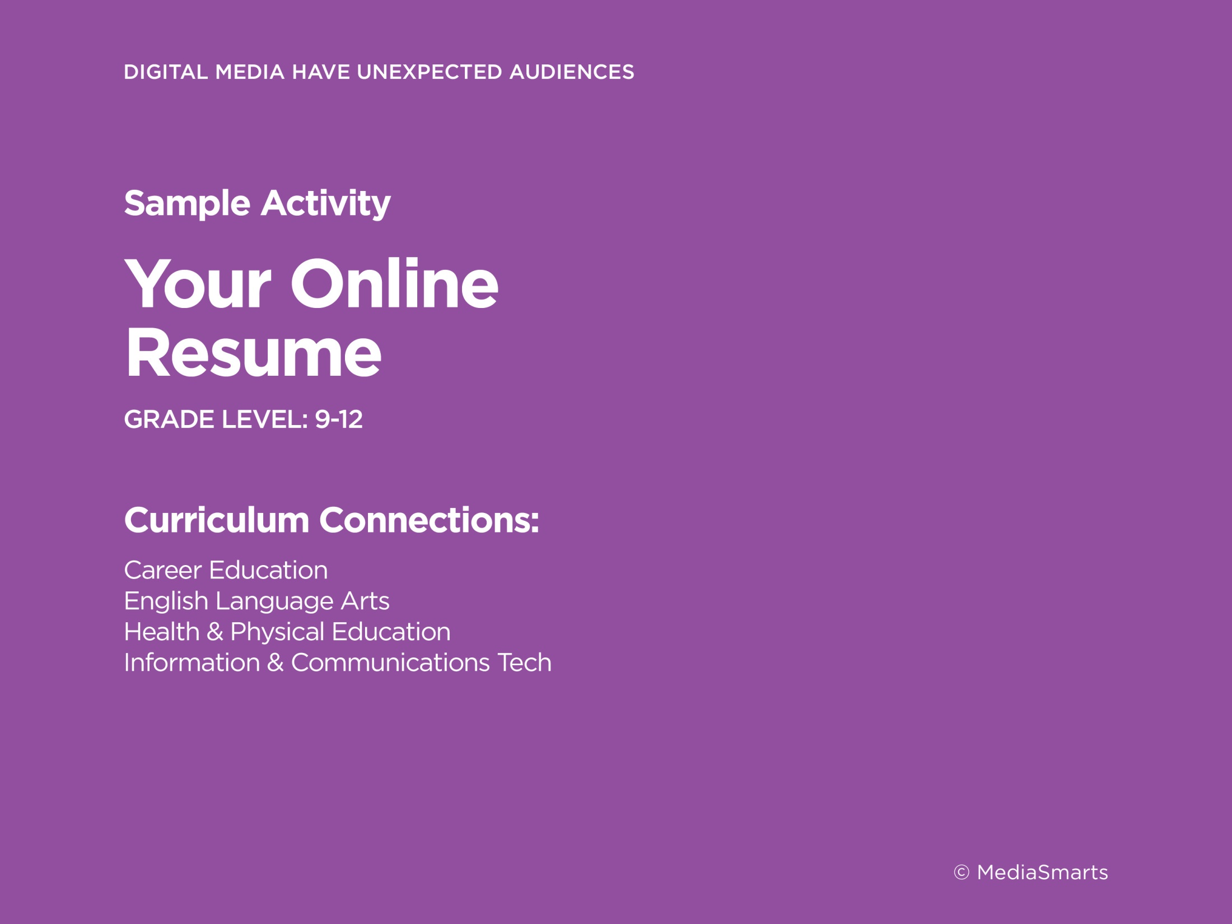
Notes:
This concept is as relevant for older kids as it is for younger ones. In particular, secondary students need to be aware of the future audiences that might see material they post, such as employers or university admissions officers. This high school lesson prepares them to not only avoid posting things that cast them in a negative light, but to build a positive “online resume” as well.
 (Next slide)

Slide 2
Notes:
It’s important for students to understand that – and to know that while having no online presence is better than having a bad one, these people are specifically looking for positive things:
evidence of community and charitable service;
accomplishments in things like academics or athletics;
content that shows you’re articulate, professional and creative;
and evidence of kindness and compassion.
Of course, they’re also watching out for negative things, like inappropriate posts, suggestive photos, and negative comments about teachers or employers.
 (Next slide)

Slide 3
Notes:
This issue doesn’t go away when students finish high school, or even enter the workforce. As teachers, you’ll deal with it your whole careers. (There’s a tip sheet in the Guide called Taking Control of Your Online Identity with some specific tips on dealing with this.)
Let’s do an exercise from the lesson and find out what the Internet has to say about you. Do a search for your name (you may need to add some extra search terms if it’s a common one). Don’t forget to do an image search as well as a general Web search! Finally, take a quick look at what’s visible on any social networks you use.
Give participants about 5 minutes to do this.
 (Next slide)

Slide 4
Notes:
Now think about how you can build your online brand into something positive.
The value of a brand is that it isn’t just a name, it communicates an idea as well. Think about Apple: they are able to charge more for their products because the brand is associated with being cool and high quality. What do you want your brand to “say” about you?
Now think about three audiences or groups of people who might see your content online.
For each one, think about:
Your platform – What’s the best way to reach them?
What message do you want to send them about yourself?
How can you hide bad content or fix a bad impression?
Finally, what will tell you if you’ve been successful?
Give participants about 5 minutes to do this and ask some to share their work.
 (Next slide)

