Slide 1
Health Assisting
Catarina Alves, Valerie Martin, Rebecca Torcia

Slide 2
Health Assisting Teachers
Valerie Martin
Catarina Alves
Rebecca Torcia
martinv@springfieldpublicschools.com
Google number: (413) 893-4507
Office Hours: Thursday
alvesc@springfieldpublicschools.com
Google number: ‪(413) 308-0184‬
Office Hours: Thursday
torciar@springfieldpublicschools.com
Google number: (413) 308-2996
Office hours: Thursday

Slide 3
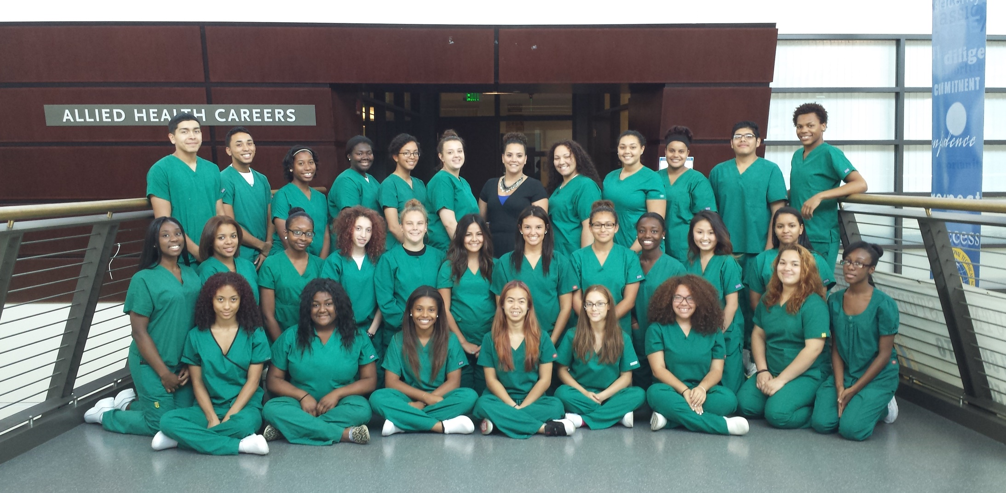

Slide 4
Mission Statement
The Allied Health Program at Roger L. Putnam is the most exciting technical education shop due to the diversity offered to our students to learn and implement knowledge and skills to provide high quality care to individuals in the community. The program allows students to provide a service within the community which will give them a sense of pride that they are enriching another individual and families’ life. We continue to strive and be one of the most popular shops at Roger L. Putnam because we provide a safe, clean, friendly, enriching, and creative environment to our students.

Slide 5
Course Objectives
Students will obtain hands on experience following the standards set by the Department of Education in our hospital lab, to obtain practice on their skills for their CNA licensure daily at school.
They will obtain 21 hours out in the community at a long-term care facility totaling 75 hours of course instruction.
Students will obtain lectures following the standards set by the Department of Education prior to lab time to insure they fully understand the purpose of the skills they are performing in the hospital lab and out in different clinical settings in the community. This information will ensure our students have a sound knowledge base to provide an optimal level of care to their patients once they obtain their Certified Nursing Assistant licensure
Students will develop interpersonal, organizational and problem-solving skills.

Slide 6
Health assisting
11th grade: Health Assisting is a vocational technical program with the primary focus being the C.N.A. curriculum. Students learn their skills within Putnam’s state of the art hospital lab such as the simulation lab and the knowledge and skills of our staff (Registered Nurses).
12th grade: Health Assisting is a vocational technical program that provides students with opportunities to provide direct and indirect care to individuals in the community under the direction and supervision of our staff (Registered Nurses). Students will be able to expand and emphasize their skills and knowledge in order to obtain a Certified Nursing assistant licensure and provide quality care.

Slide 7
Syllabus
Please click on the link to access our Syllabus for Health Assisting
https://drive.google.com/file/d/1DR11C5Lpy9BfSWkcU5QfP_fsU85lbfi-/view?usp=sharing

Slide 8
Certification achieved in Allied Health
Certified Nursing Assistant
Home Health Aide
CPR
First Aid
Alzheimer's Training
OSHA

Slide 9
CVS Health Pharmacy Technician
Some of our students for CO OP will have the opportunity to become a CVS Health Pharmacy Technician which allow them to use their knowledge and skills to help thousands of people get the medications they need to improve their health.

Slide 10
Certified Nursing Assistant
Some of our students for CO OP will have the opportunity to work as Certified Nursing Assistant in many different healthcare facilities that we have affiliations within the community to help students gain experiences, network and build their resumes.

Slide 11
Acute observation Rotation at Baystate medical center
Provides some of our students with ample knowledge of the health care system
Offers students observation of different areas within acute care setting this will help provide them with the knowledge to help them in their future careers in the healthcare field

Slide 12
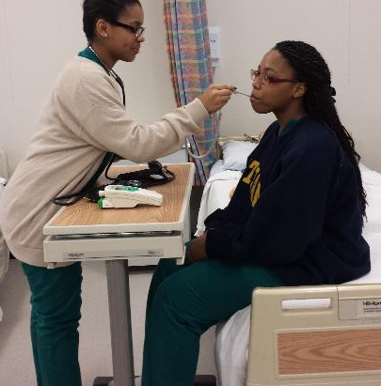
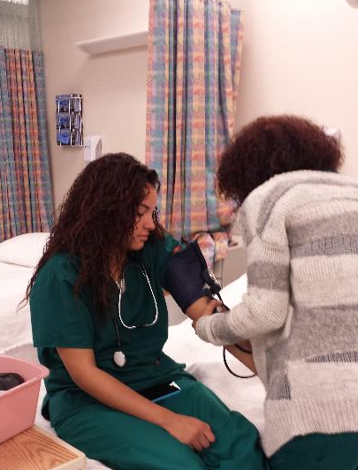
Health Assisting focus
Health Assisting is a Chapter 74 vocational technical program with the primary focus on preparing students in the health career industry as Certified Nursing Assistants utilizing industry standards. Students will learn hands on skills from the knowledge and skills of our staff (Registered Nurses), and within Putnam’s state of the art facilities, such as the hospital and simulation labs. This program provides students with opportunities to provide direct and indirect care to individuals in the community under the direction and supervision of our staff (Registered Nurses). Students will be able to expand and emphasize their skills and knowledge in order to obtain a Certified Nursing Assistant licensure and provide quality care.

Slide 13
We provide students with skill videos that we have filmed to reinforce their knowledge and provide a resource that they can access anytime

Slide 14
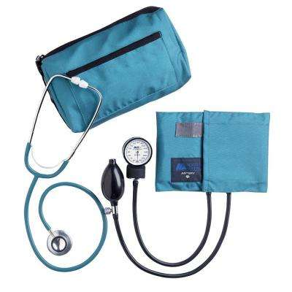
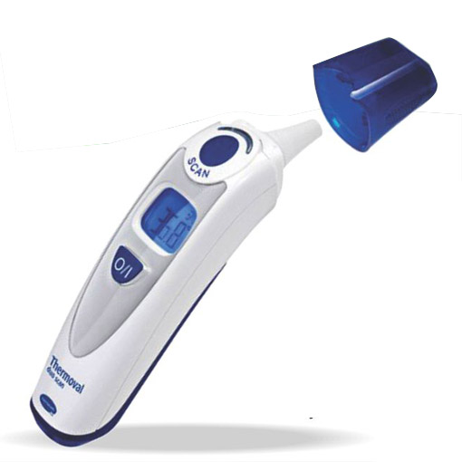
Equipment List
The following equipment is included in our program to meet the frameworks and industry standards:
12 Long term care/hospital beds
2 Digital vital sign towers
2 Sim Man
Wheelchairs
Cane/Walker/Crutches
Hoyer, Sit-to-stand
Geri Mannequins
New CPR adult and infant mannequins that detect compression rate and depth with automated lighting
Kitchen area including stove, oven, microwave, refrigerator
Computer carts equipped with computers
Personal Care items including wash basin, emesis basin, hair comb/brush, nail clippers, nail file, orange stick, standard bedpan, fracture bedpan, linen, colostomy supplies, urinary supplies, vital signs supplies
Various anatomy and physiology models for visual purposes

Slide 15
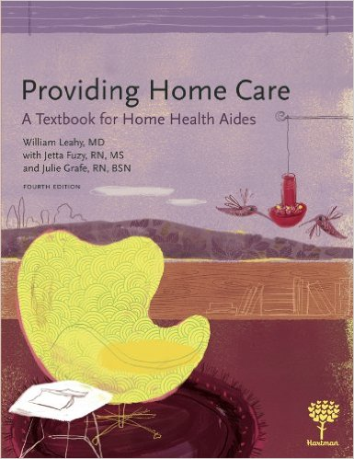
Resource List
The primary textbook used for 11th grade Health Assisting is Nursing Assisting a foundation in Caregiving and corresponding workbook (Hartman Publishing, Inc.) and for Home Health Aide training the primary textbook is Providing Home Care A Textbook for Home Health Aides and corresponding workbook (Hartman Publishing, Inc.). For Soft frameworks we utilize textbook School to Career and corresponding workbook (Goodheart-Willcox Publisher).

Slide 16
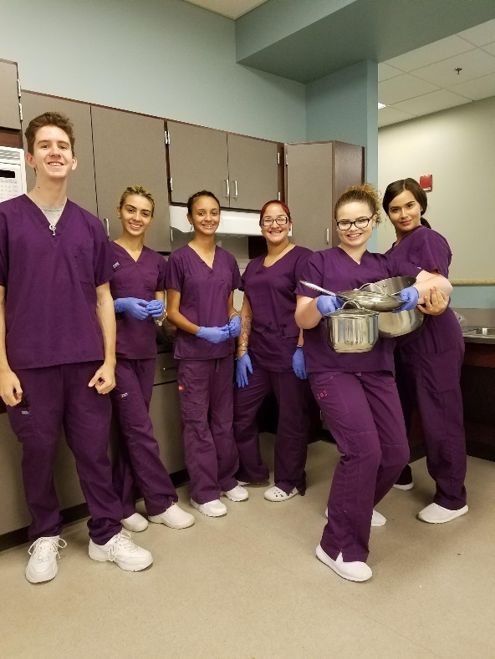
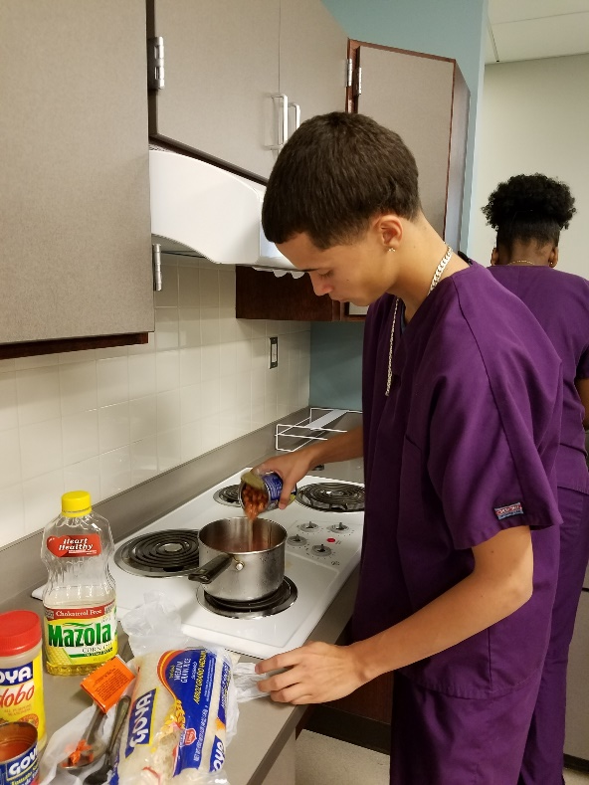
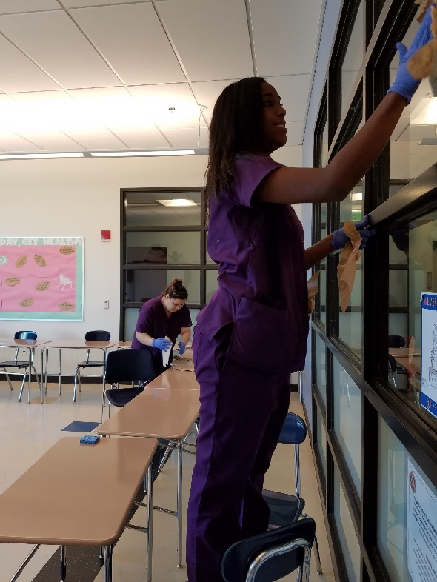
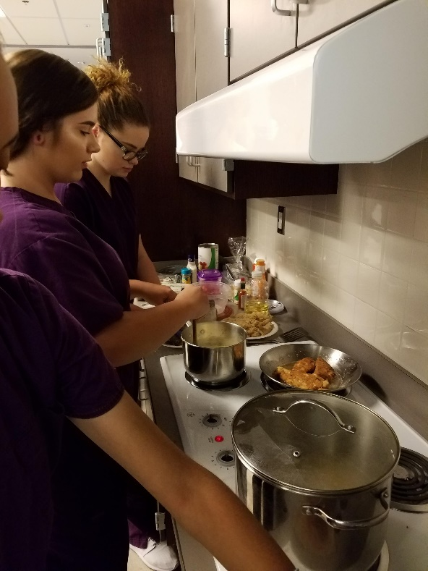
Resource List Continued…
ABCs for Direct Care Worker Curriculum for Home Health Aide training.
Caring for people with Alzheimer’s disease A Habilitation Training Curriculum for Dementia training.

Slide 17
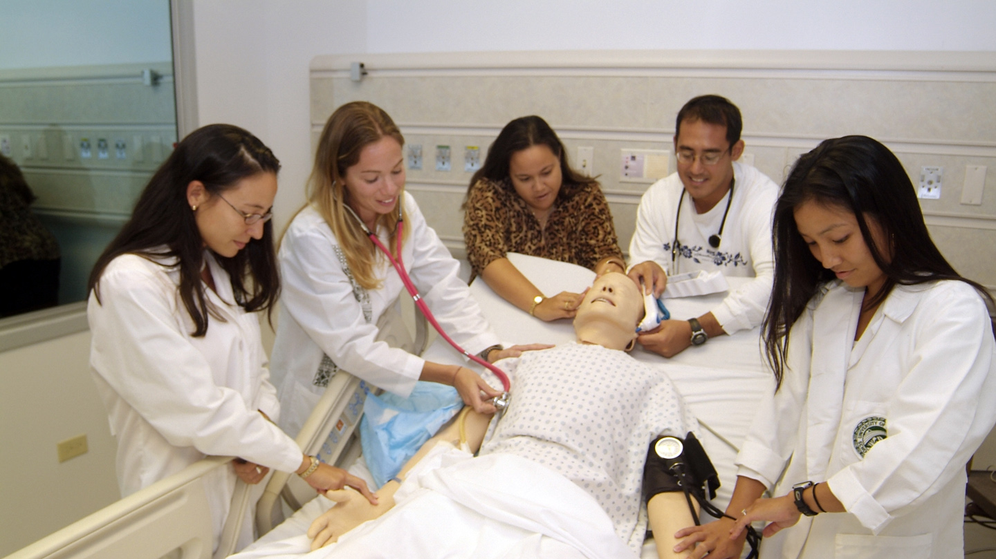
Resource List Continued…
Sim Man training scenarios for realistic health related situations students may encounter in clinical, Co-Op or industry settings.

Slide 18
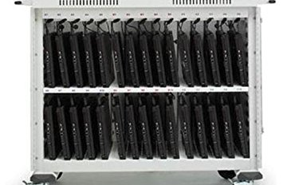
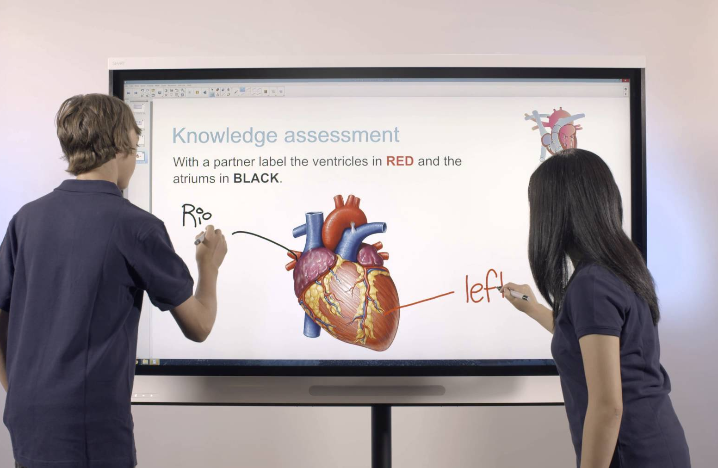
Resource List Continued…
There are 3 related classrooms equipped with smartboards. A computer lab containing desktop computers and a smartboard. Also laptop cart with laptops for student use

Slide 19
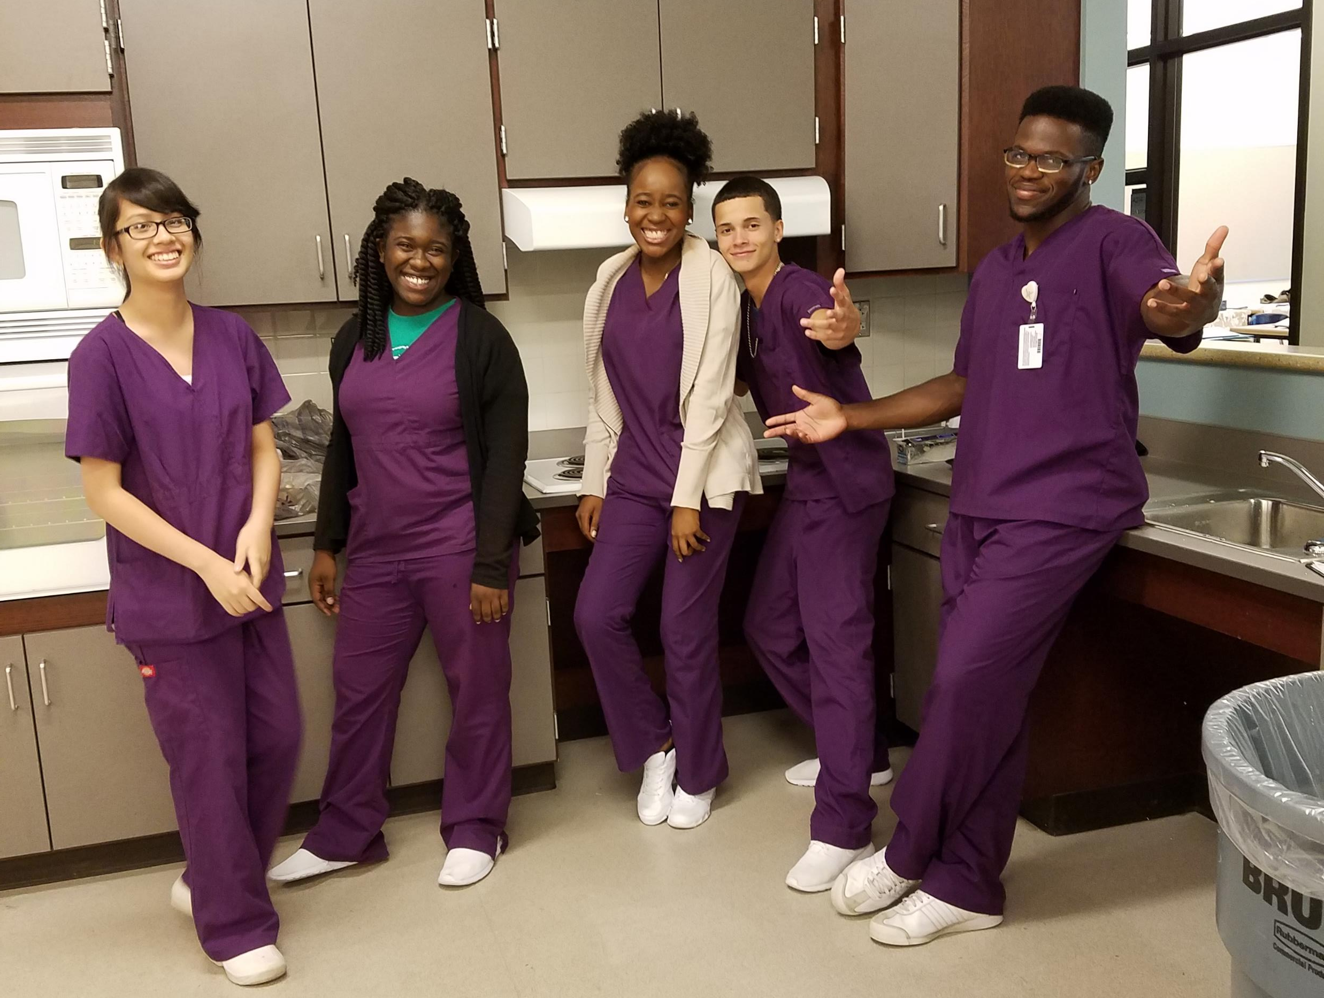
Health and Safety Policy Statement
It is the policy of Putnam Vocational Technical Academy that accident prevention shall be considered of primary importance in all phases of operation and administration. It is the intention of the school’s administration to provide safe and healthy working conditions and to establish and insist upon safe practices at all times by all staff and students.

Slide 20
Program Specific Safety Plan/Orientation
Patient Safety
Washing hands: Washing hands will prevent the spread of pathogenic organism to the patient. This is a major concern when we consider the patient’s safety.
Identify patient: Misidentification is a major safety hazard. Always make sure you have the patient who needs the treatment or medication to be administered.
Explain the procedures to the patient: An informed patient is more likely to be a cooperative patient. A cooperative patient makes it easier to complete the task in a safe manner.
Provide privacy: One again, this will help assure a more cooperative, relaxed patient. One who is worried about having his body exposed to others, may be less cooperative, making it harder to complete procedure in a safe manner. (HIPAA)

Slide 21
Program Specific Safety Plan/Orientation
Patient Safety Continued..
Leave patient comfortable, with call light in reach: Making the patient comfortable with everything he needs will prevent him from trying to each for something or getting out of bed when he should not, resulting in a fall. Having the call light allows him to call for anything we may have forgotten.
Preventing burns: Check water temperature of solutions for bath water, enemas, hot wet packs and other treatments. Position the patient’s tray so hot liquids will not spill. Assist patent with hot liquids if they have difficulty in handling them alone. Check the skin frequently when treatments such as hot wet packs or heat lamps are used. Check electrical equipment for problems such as frayed cords or broken plugs before use.

Slide 22
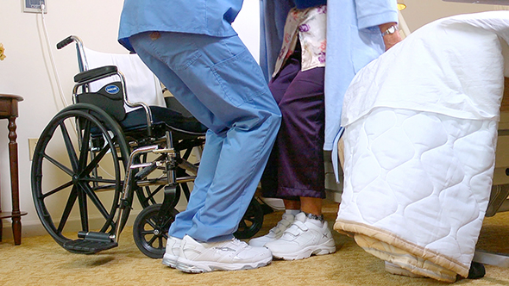
Program Specific Safety Plan/Orientation Body Mechanics
Body mechanics refers to the efficient use of our bodies as we move and work. Good body mechanics prevent injury and fatigue, increase efficiency, improve health and appearance, and set good examples for others to follow.

Slide 23
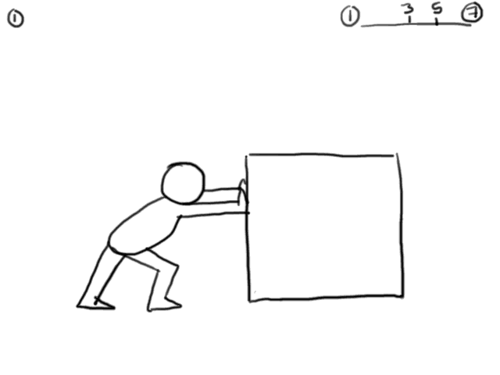
Program Specific Safety Plan/Orientation Body Mechanics
Knowing the basic principles of physics at work in body mechanics will help make your work easier and more efficient. The center of gravity is the point in the body in which mass is centered. In humans that point is in the pelvic area. The important principle is the line of gravity, an imaginary vertical line that passes through the center of gravity.

Slide 24
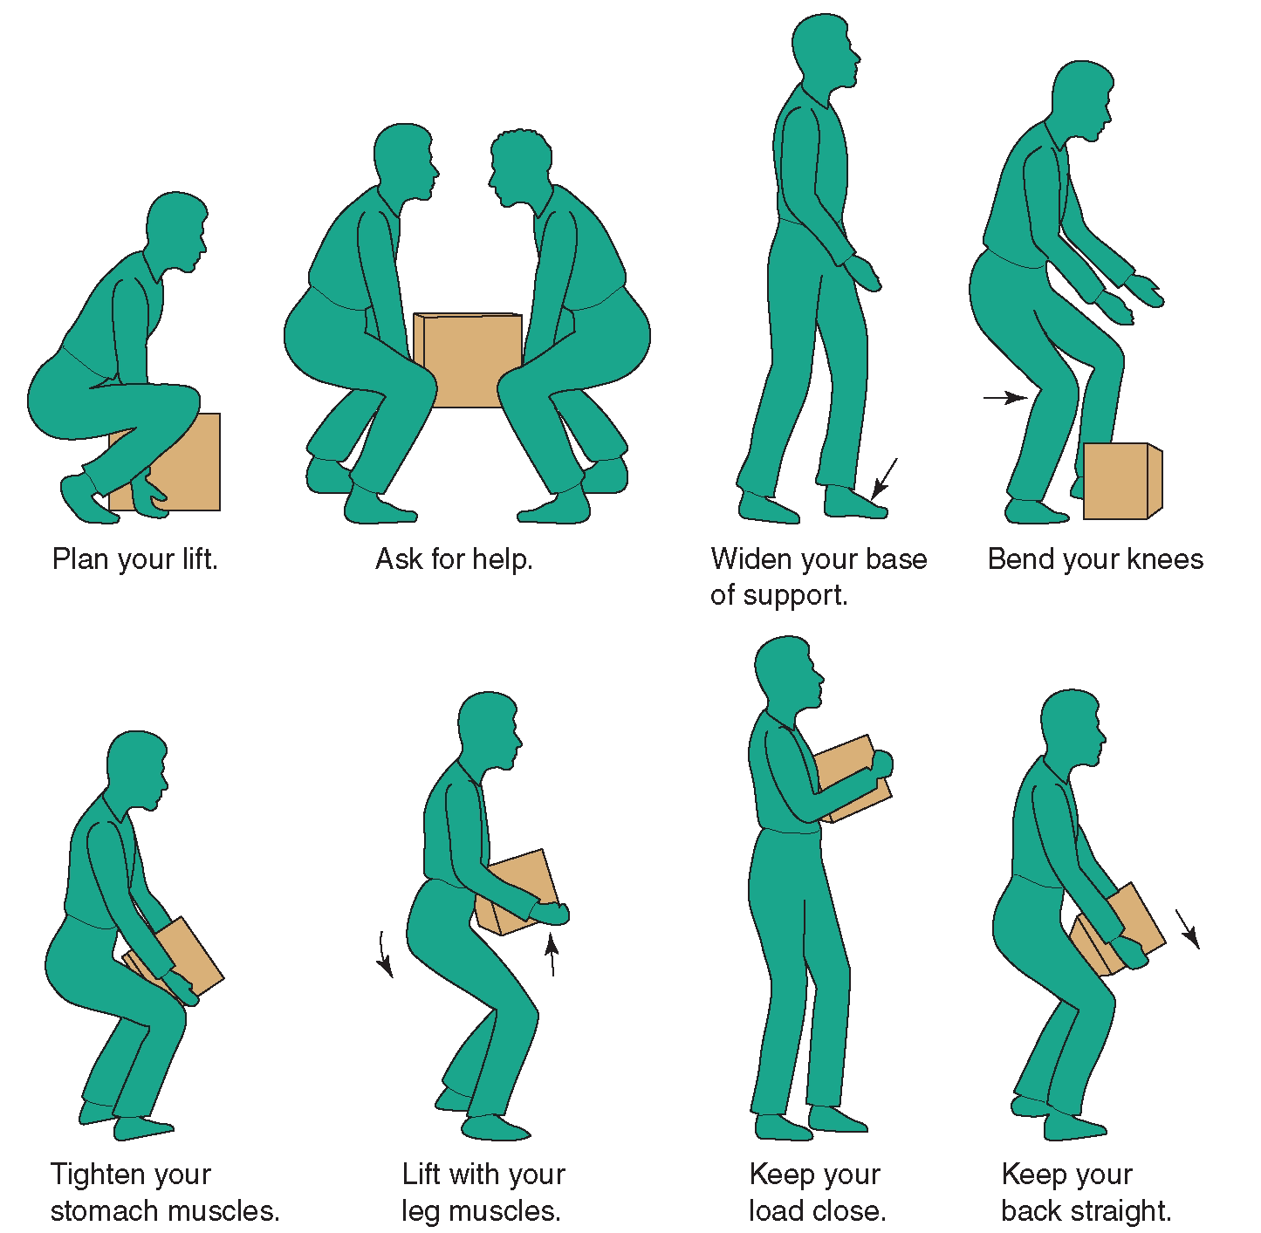
Program Specific Safety Plan/Orientation Body Mechanics
Balance is more stable when the base of the support is broad, and the line of gravity passes through the center of gravity and near the middle of the base of support. Balance is more stable when the center of gravity is low.

Slide 25
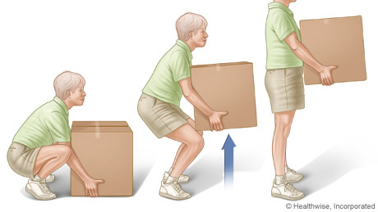
Program Specific Safety Plan/Orientation Lifting
We have many muscle groups to aid us in moving and working. Some are larger and stronger than others. If we use these large muscles, we can prevent injury to ourselves. The muscles of the upper arms and upper legs are larger ones. These are the muscles we want to use in lifting and moving.

Slide 26
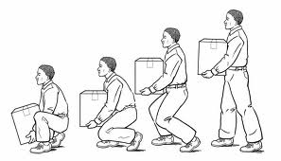
Program Specific Safety Plan/Orientation Lifting
Our back muscles are not very large or strong. We want to spare them. There are several ways to make sure we use the right muscles groups.
Bend the knees and keep the back straight when stooping and lifting
Get as close to the work as possible to prevent reaching. In the clinical area, some of our equipment is made to make this easier. Beds can be raised to a comfortable working level. Side rails can be lowered to get closer to the patient.
Use ladders or step stools to get closer to objects that are higher than we are.
Carry objects close to the body.
Avoid twisting with a load.
Avoid sudden jerking movements when lifting.
Slide, roll or pivot an object to avoid lifting whenever possible.
Use body weight to push or pull an object.
Face the work to be done.
Ask for help when the load is large.

Slide 27
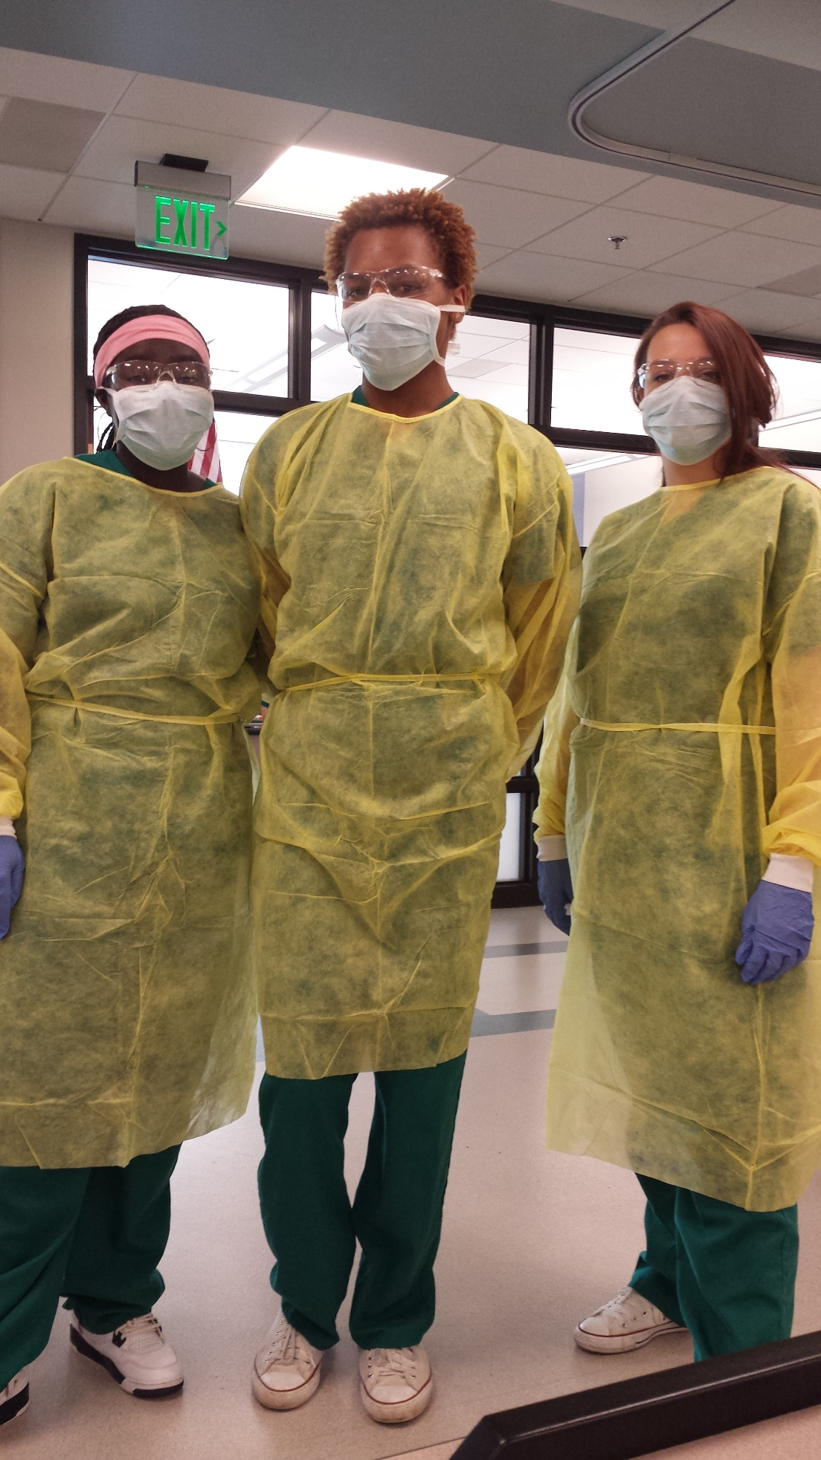
Program Specific Safety Plan/Orientation Personal Protective Equipment Clothing
Where there is a danger of flying particles or corrosive materials, teachers and students must wear protective goggles and/or face shields approved by SVS.
Teachers and students are required to wear safety glasses at all times in areas where there is a risk of eye injuries such as punctures, contusions or burns.
Teachers and students who need corrective lenses are required to wear only approved safety glasses, protective goggles, or other medically approved precautionary procedures when working in areas with harmful exposures, or risk of eye injury.

Slide 28
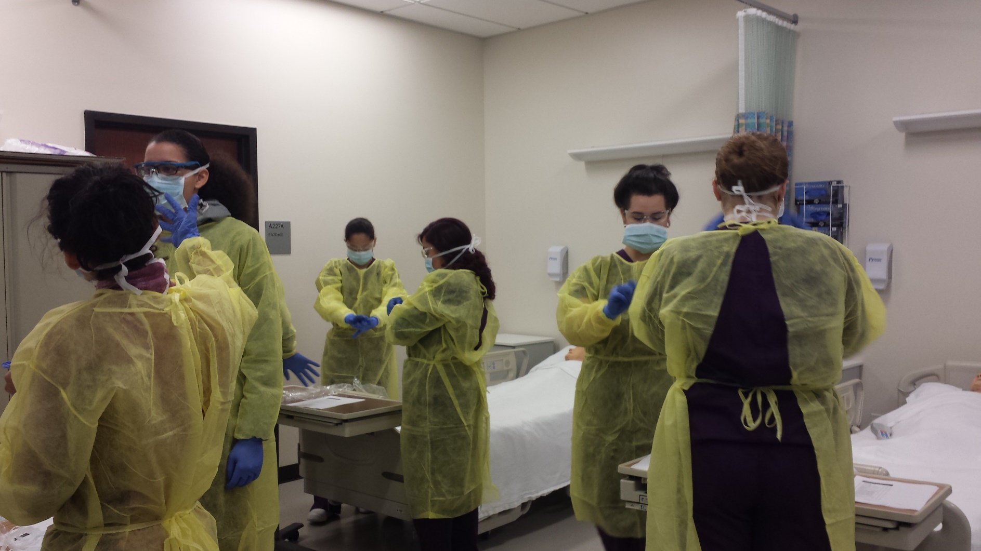
Program Specific Safety Plan/Orientation Personal Protective Equipment Clothing
All safety equipment must be maintained in sanitary condition and ready for use. Report any defective equipment immediately.
An eye wash facility is located in each shop and the science labs.
If an irritant gets into a teacher or student’s eyes, call for medical assistance immediately and flush the eye out with clean water.
Food is not to be eaten in work areas, or in places where there is any danger of exposure to toxic materials or other health hazards.
In cases of cleaning toxic or hazardous materials, protective clothing provided must be worn.

