Slide 1
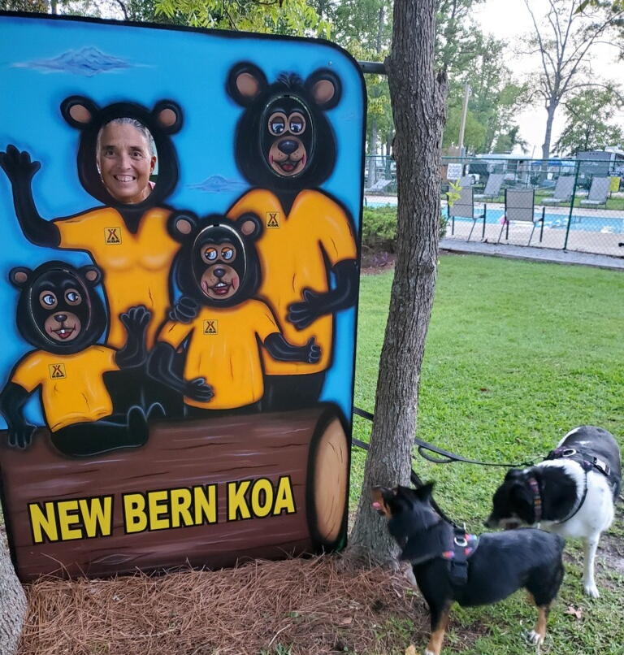


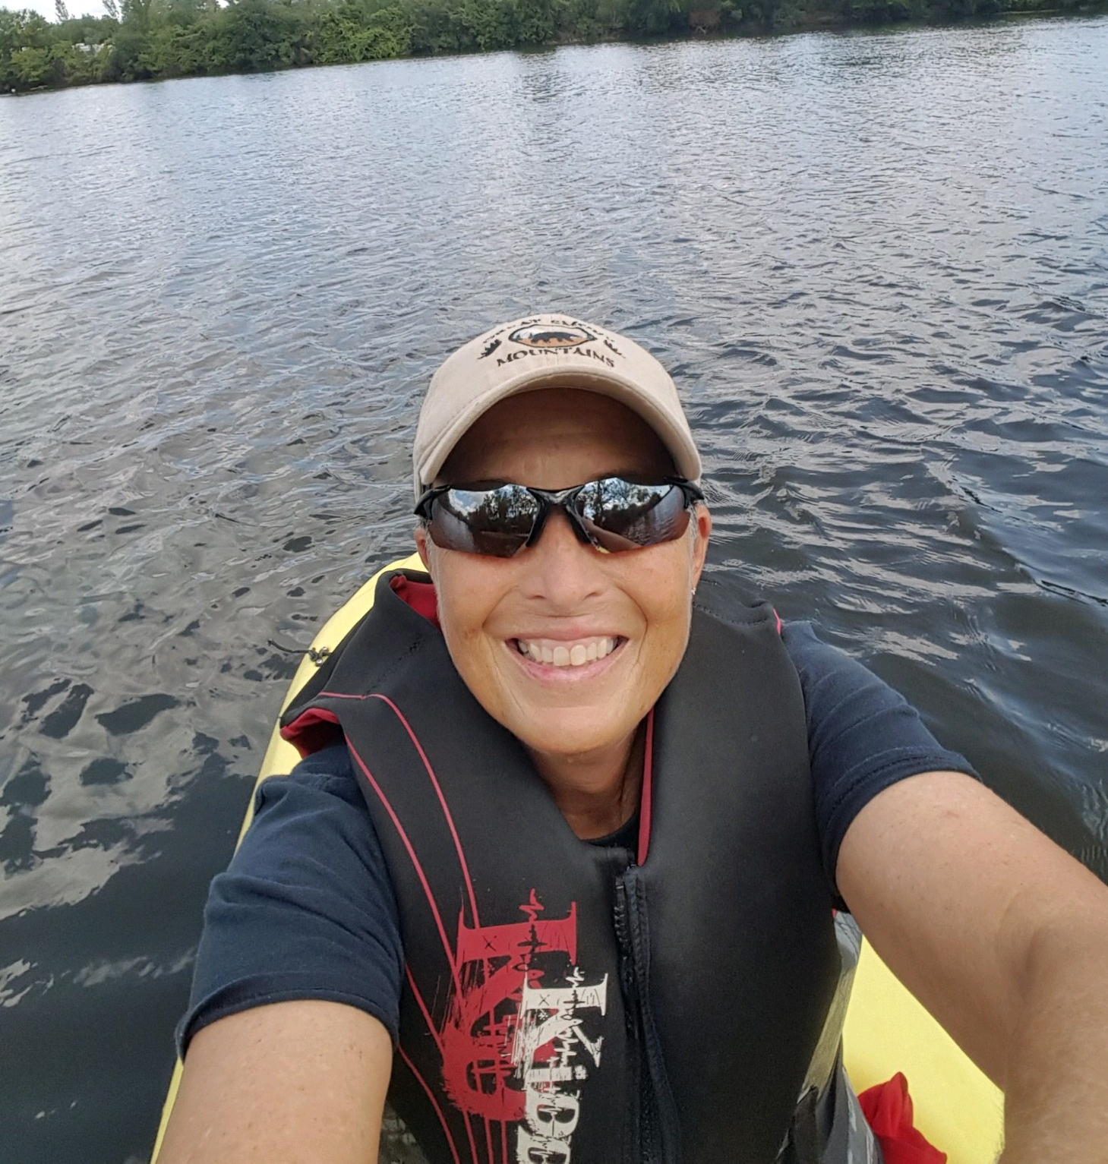
PE and Health
Come to class every day with a smile.
Participate and be engaged
Be mindful of your personal health and wellbeing in and out of class
Apply what you learn to your everyday life
Ask lots of questions. This class is about you and your body. What do you want to know?
Have fun
Stay safe and healthy
Ms. Supinski and Ms. Jordan

Slide 2
You can email and reach out to us for help at anytime! If you can’t make office hours we are always open to making an appointment at a different time.

Slide 3
Zoom Links
PE Zoom Links:
A Week: https://springfieldpublicschools.zoom.us/j/94601352052?pwd=UjFHZ3U4YkFtQVA1UCtpOGUyVG8wUT09
B Week:
https://springfieldpublicschools.zoom.us/j/95154807155?pwd=UlNLRXB1SEJzaHFiU1R6WXZhS09xZz09
Office Hours: https://springfieldpublicschools.zoom.us/j/94601352052?pwd=UjFHZ3U4YkFtQVA1UCtpOGUyVG8wUT09
Health Zoom Links:
A Week: https://springfieldpublicschools.zoom.us/j/94952000356?pwd=TGNveEliOElraUhTZERHM0h2R1JaQT09
B Week: https://springfieldpublicschools.zoom.us/j/94952000356?pwd=TGNveEliOElraUhTZERHM0h2R1JaQT09
Office Hours: https://springfieldpublicschools.zoom.us/j/94601352052?pwd=UjFHZ3U4YkFtQVA1UCtpOGUyVG8wUT09

Slide 4
The PE Department
Ms. Supinski - supinskim@springfieldpublicschools.com
Google Number: 413-351-9547
Ms. Gage - gagebr@springfieldpublicschools.com
Mr. Murphy - murphyr@springfieldpublicschools.com
Mr. Maisonet - maisonetd@springfieldpublicschools.com
Ms. Jordan - Student teacher who can be reached through Ms. Supinski

