Slide 1
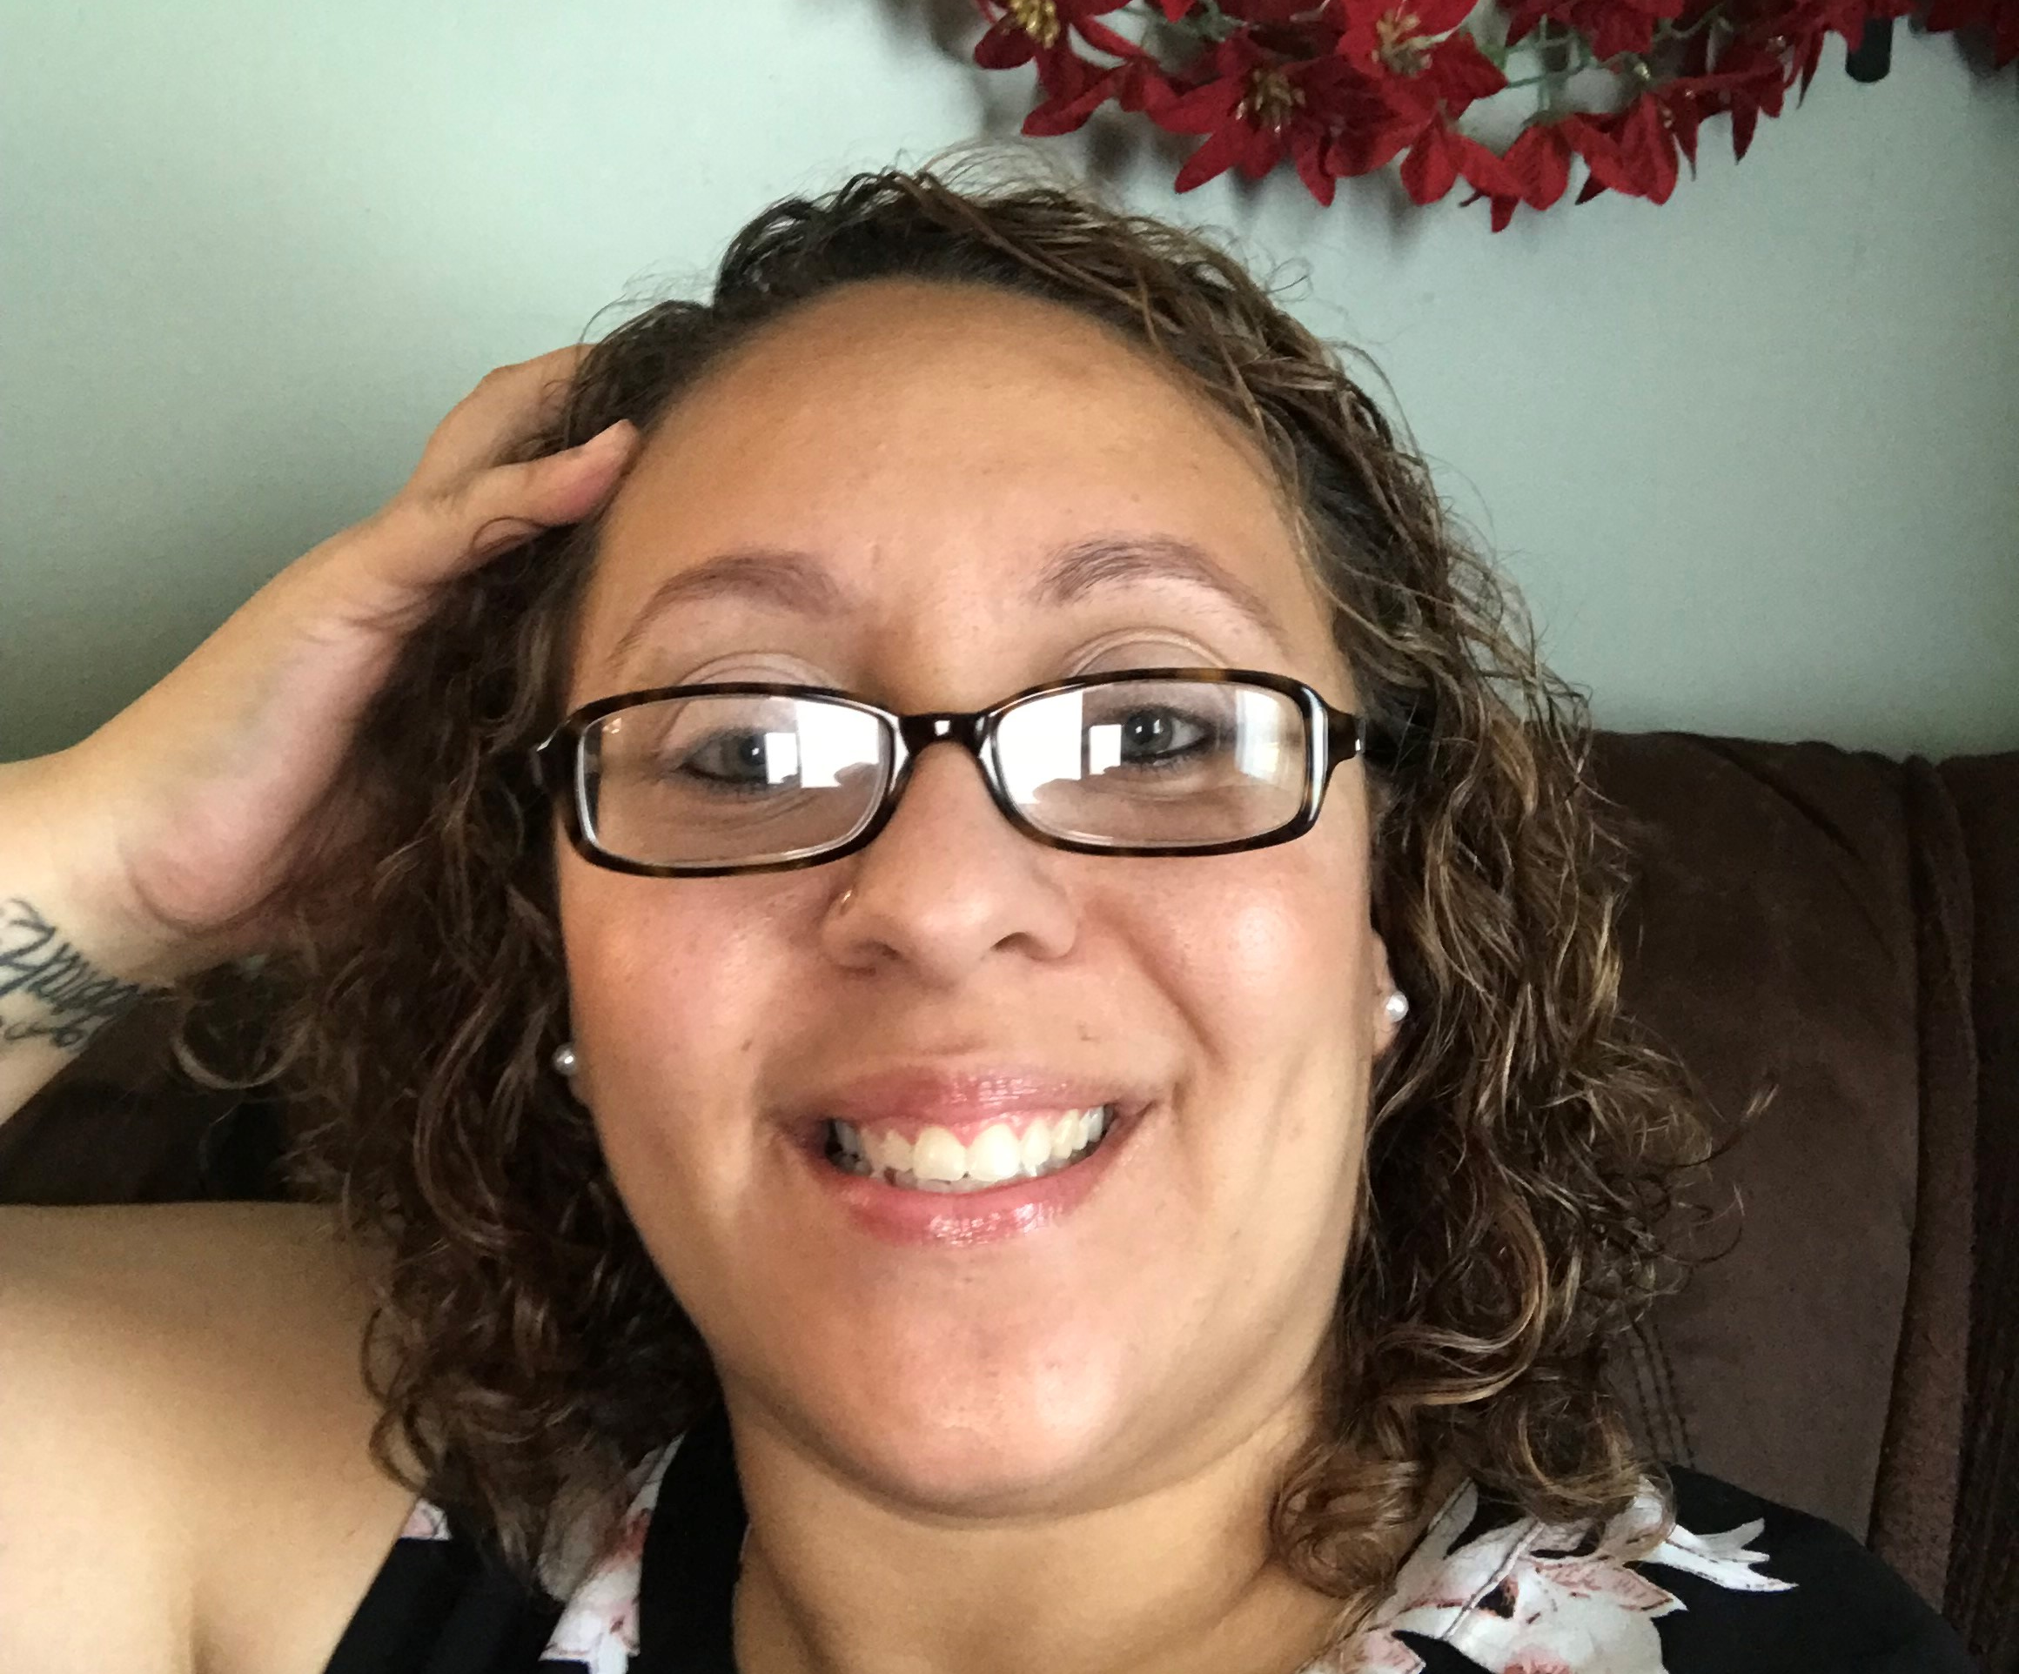
Ms. Jolly
9th and 10th Grade
Early Education teacher

Slide 2
Contact Info
Email:
jollyd@springfieldpublicschools.com
Google #:
413-351-9437
Office Hours
M,T,W,F 7:00-3:00
Th. 7:00-3:30

Slide 3
Educational Background
I have an associate's degree in Early Education from STCC as well as a bachelors degree in Early Education from BayPath University.

Slide 5
Grading is as follows
Exploratory can receive up to 13 points daily
0-3 points for attendance
0-3 points for shop activities/technical skills
0-3 points for shop academic integration
0-4 point for professionalism
9th and 10th grade are graded on
On time- 20 points
Uniform- 10 points
Insubordination- 10 points
Participation-30 points
Standard skills- 25 points
Assessments- 5 points

Slide 6
9th Grade Syllabus

Slide 7
These are the Unified Class pages where assignments and agendas are located as well as grades.

Slide 8
Daily Meetings
Daily we have a Microsoft Team call set up so we can have a video class. Each student should be assigned to the corresponding team.

Slide 9
Students
These are some of our students celebrating friendship day!!

Slide 10
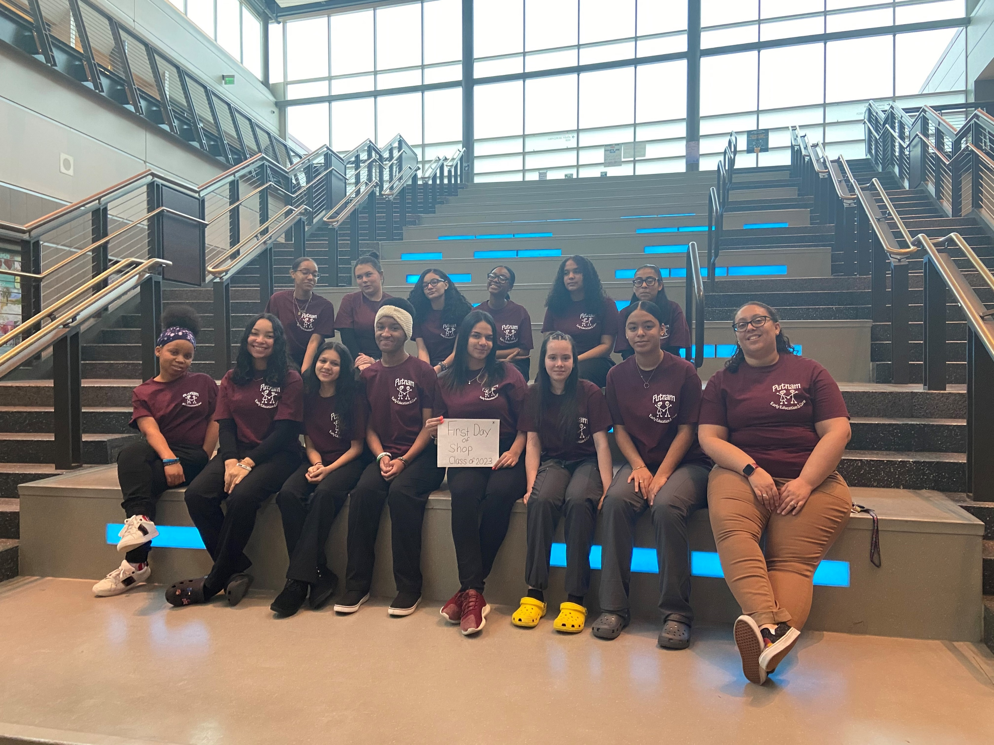
Class of 2023
This was our incoming freshmen last year on their first day of shop!!

Slide 11
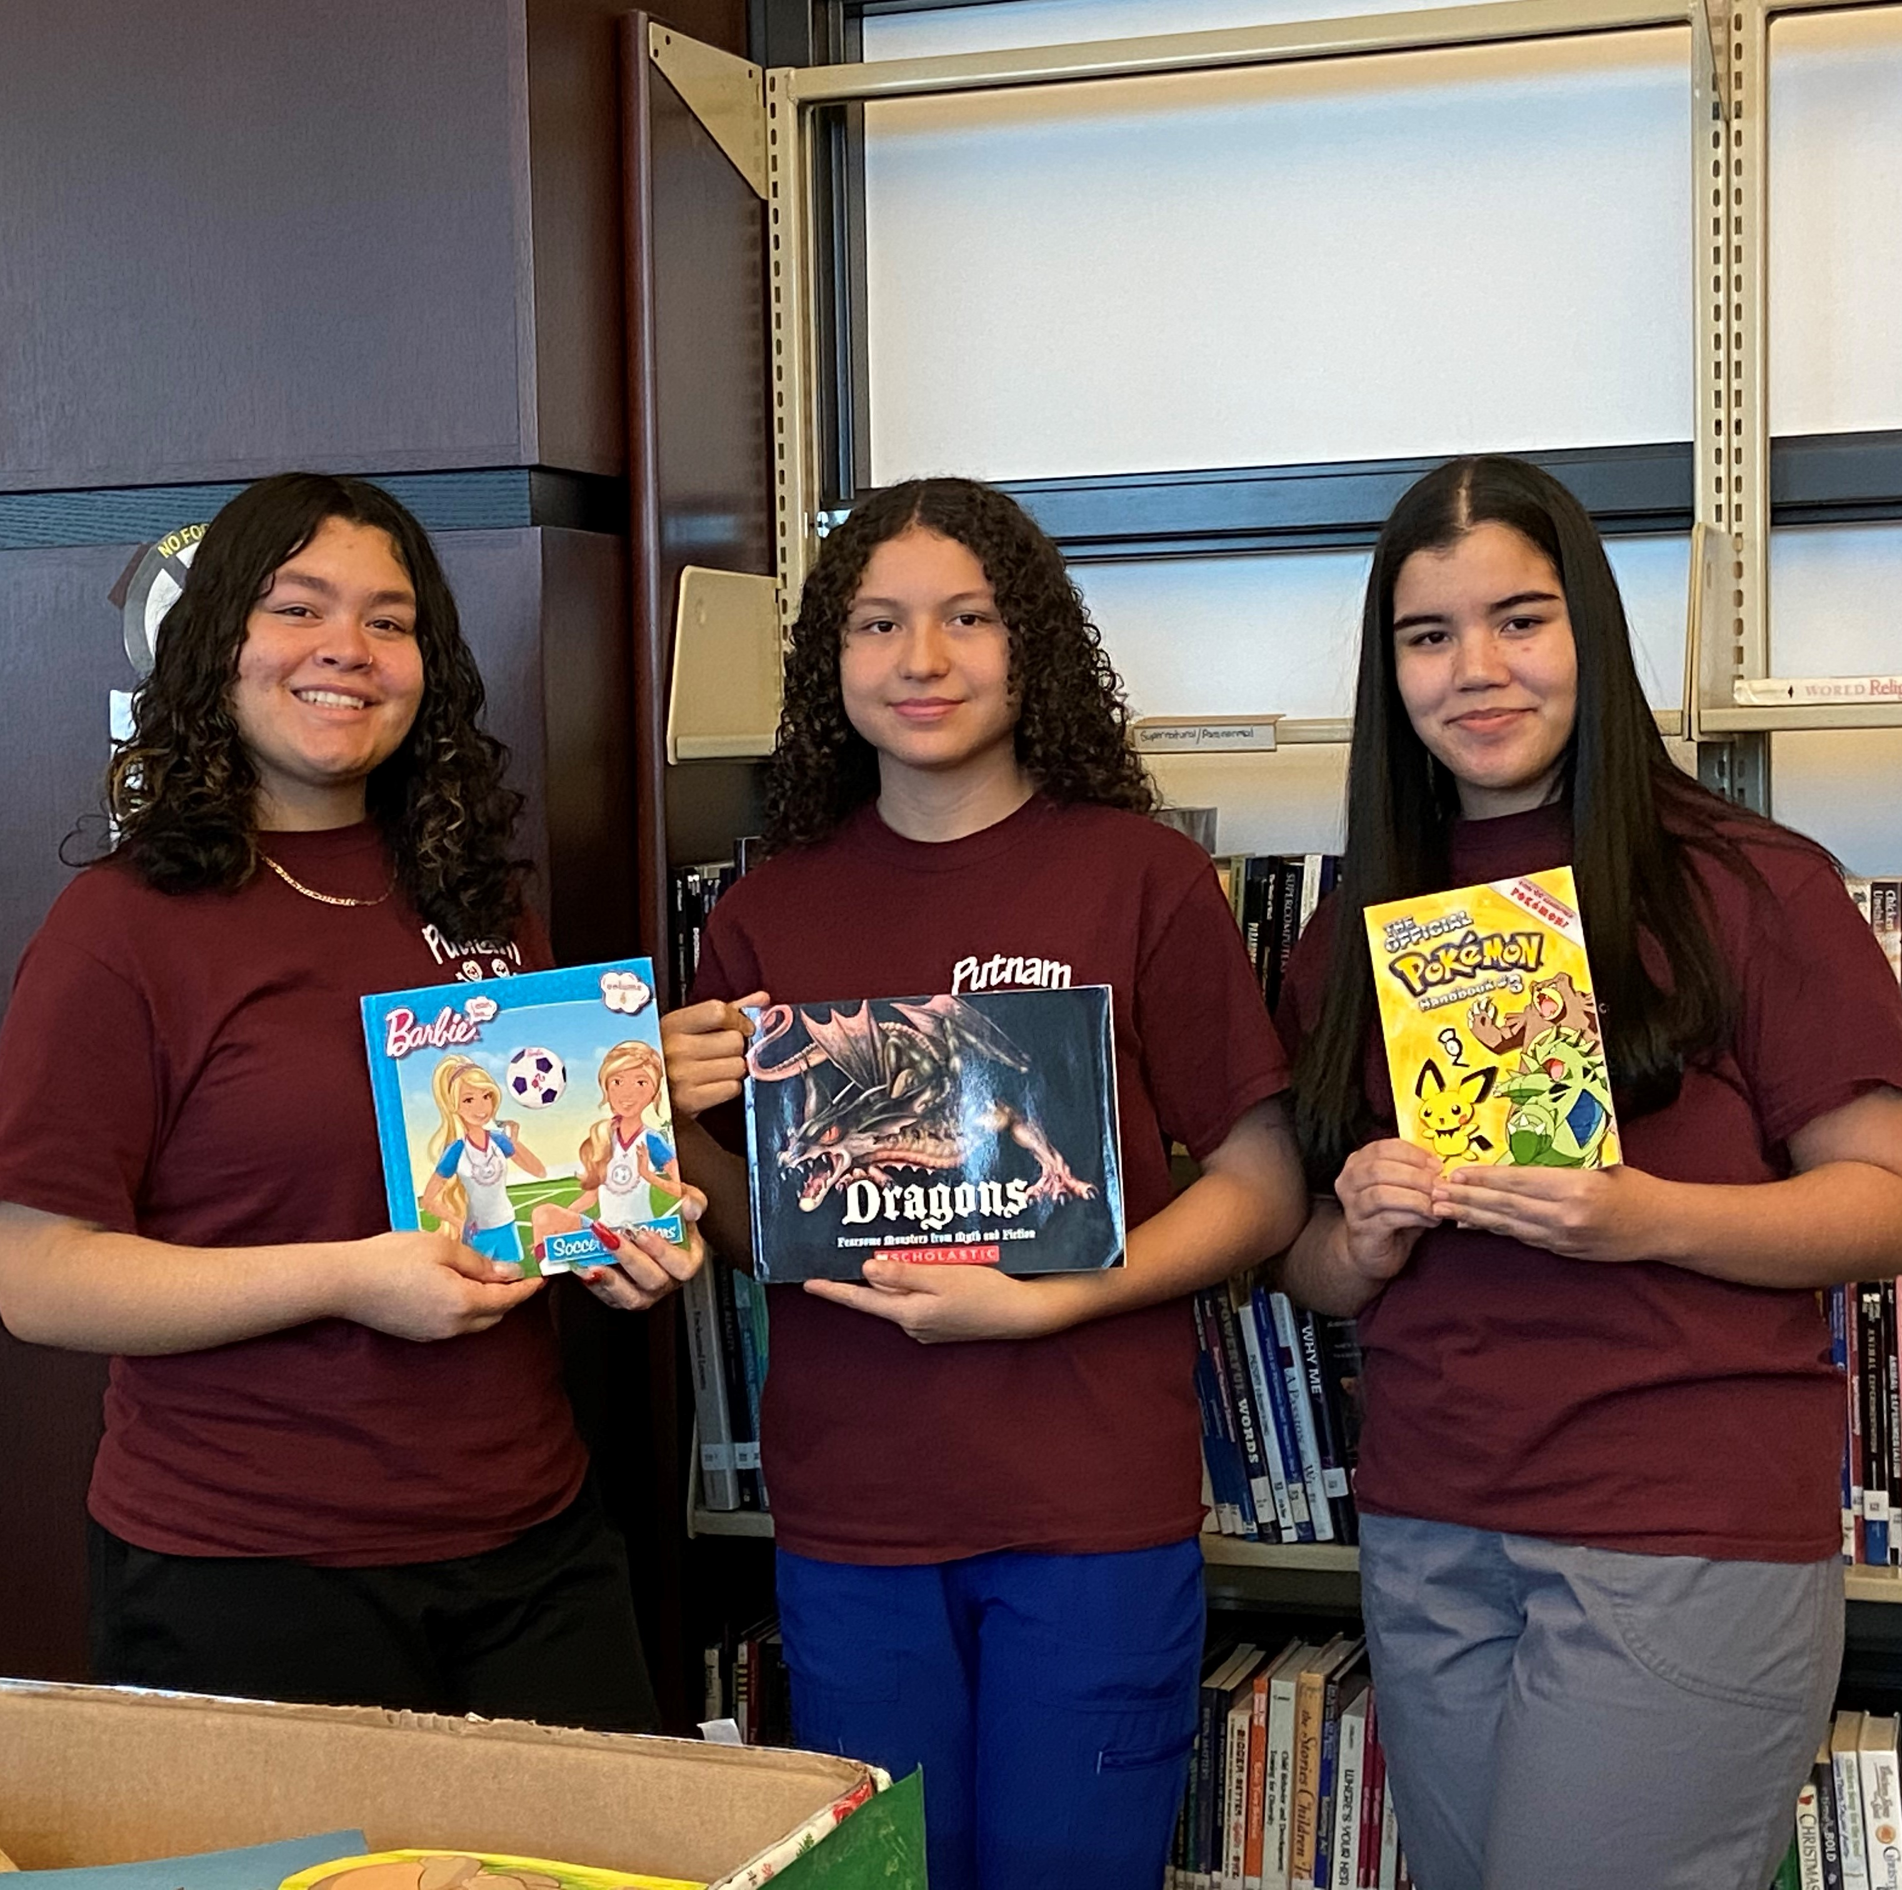
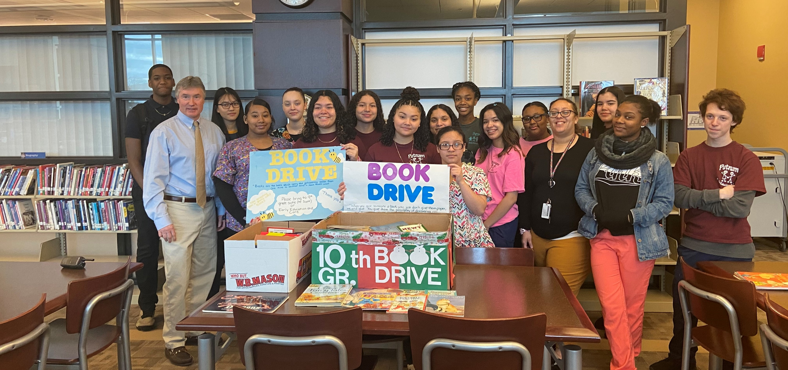
Book Drive
Last year 10th grade students were able to collect over 50 books to donate to schools locally as well as the HCS Headstart classroom in Putnam. After collecting the books students had the opportunity to go to the classes and read to the students!

Slide 12
Student Help Desk
Students facing school-related technology issues may receive assistance by call, email or live chat.
PHONE: (866) 552-0486
LIVE CHAT: https://support.customms.com
EMAIL: studenthelpdesk@springfieldpublicschools.com

