Slide 1

Cosmetology
Mrs. Calhoun

Slide 2
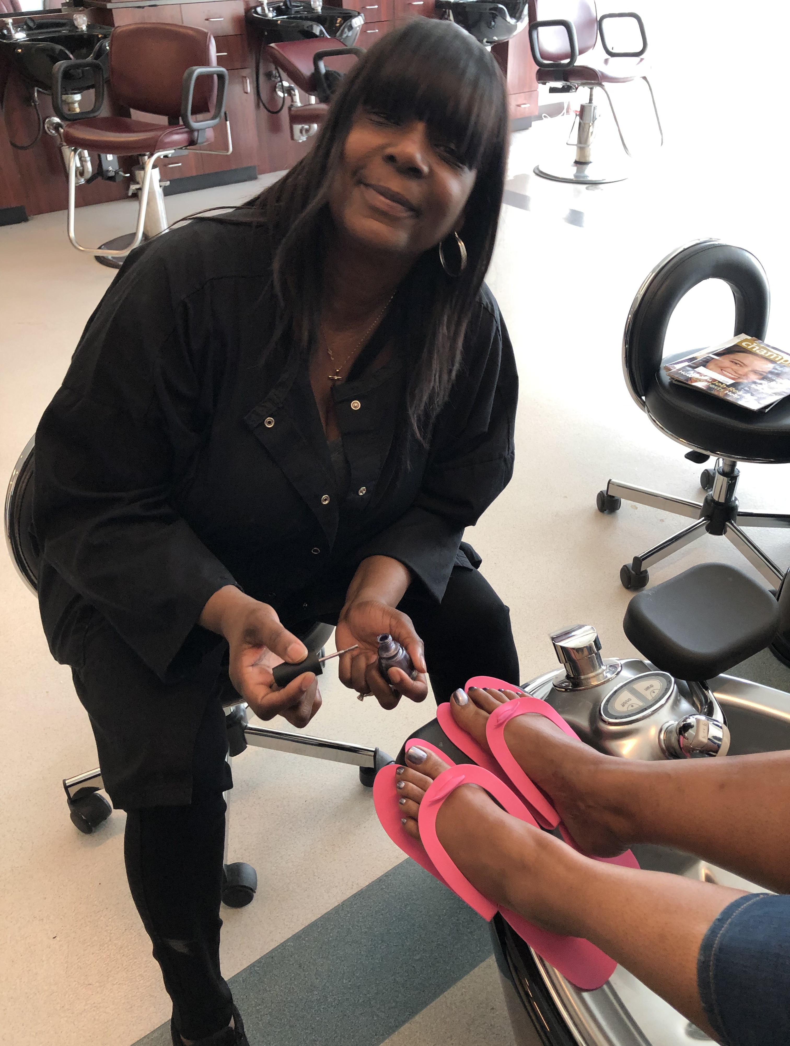
About Me
Students will be under the instruction of me, Mrs. Calhoun.
With over 25 years of experience in the Cosmetology Industry– teaching in private and public sectors.
I will be teaching the Arts and Sciences of Cosmetology that includes hair, skin, and nails.
  Currently teaching Cosmetology to 9th and 12th grade students.
After the completion of the Cosmetology program and earning 1,000 hours, students will be eligible to take the State Boards test and receive their cosmetology license.

Slide 3

Remote Learning Information
Students will have access to “Microsoft Teams” for class meetings where classes begin at 7:35am and assignments.
The team link can be accessed through Unified Classrooms in the Cosmetology page.
This Photo by Unknown Author is licensed under CC BY-SA

Slide 4
Microsoft Teams
Please make sure your cameras are on and accessible during class meetings.
Assignments are assigned through Microsoft Teams and are submitted to me through email.
The textbook and workbook is also accessible through Microsoft Teams for easy access.
In addition, students can connect with myself and each other regarding questions and classwork through posts found on Microsoft Teams.

Slide 5
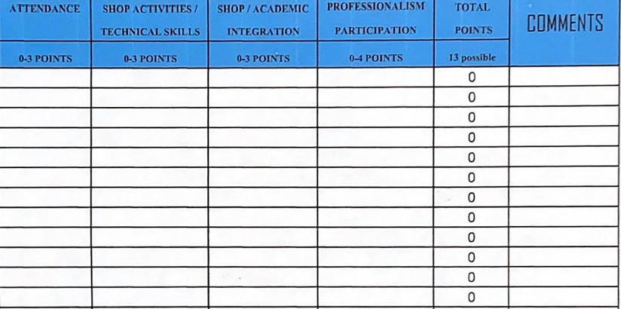
Grading Rubric
Students can earn a total of 13 points a day
Students will be graded based on:
  Attendance
  Shop activities/technical skills
  Shop/academic integration
  Professionalism and Participation

Slide 6
Contact Information
Email- CalhounJ@SpringfieldPublicSchools.com
Google voice- (413)-271-7219 (call or text)
Also available through Zoom
  Meeting ID: 259 895 3775
  Passcode: putnam1
Office hours- available by appointment

Slide 7
Technology Issues
Students and parents experiencing school-related technology issues can get assistance by call or email. The bilingual Student Help Desk is available 7am-8pm Monday through Friday (excluding holidays)
Phone- (866)552-0484
Email- studenthelpdesk@springfieldpublicschools.com

