Slide 1
Open House
Mrs. Gregory
Read 180, Grades 9 & 10
2020-2021

Slide 2
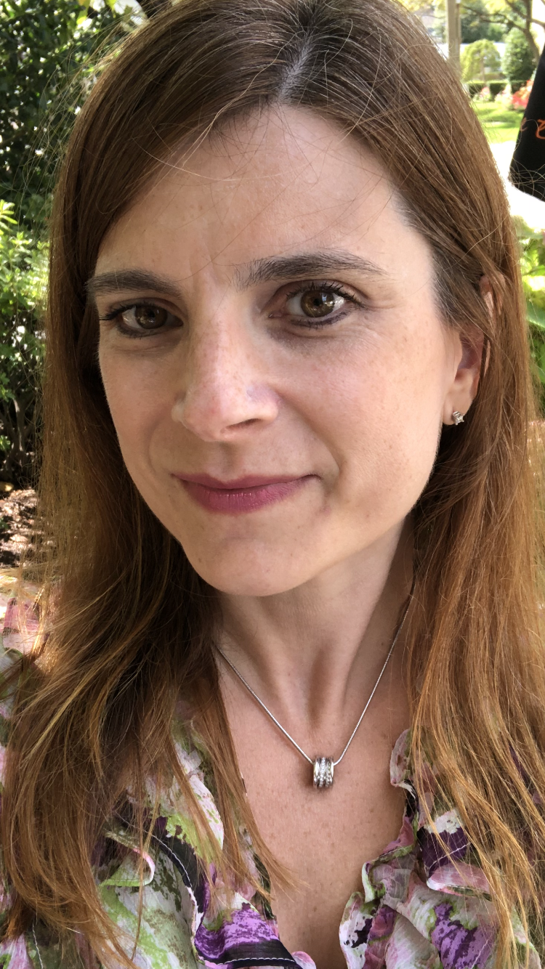
Mrs. Gregory, M.Ed, Ed.S.
This is my 9th year at Putnam. I have a 6th year degree in Special Education from Bay Path College, a Master’s degree in Education from Cambridge College, and a Bachelor's degree in Psychology from Bay Path College.
Email: gregoryj@springfieldpublicschools.com

Slide 3
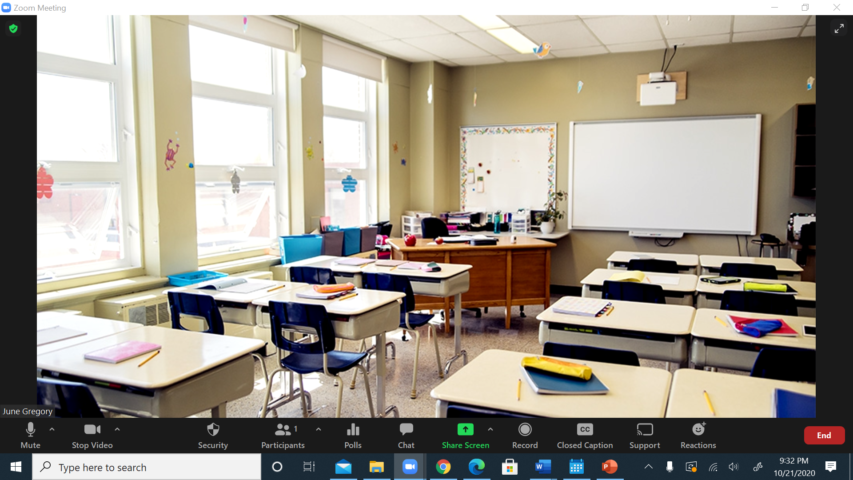
Welcome Parents!
Welcome to: Putnam Vocational Technical Academy
Open House Date:
  What does the virtual classroom look like?
  What is expected from your child?
  What resources will be used in the Read 180 Program?

Slide 4

Curriculum Goals
Read 180 is an intense, comprehensive reading intervention program used to increase students’ reading levels. Each student receives instruction that is individually designed for their current reading level and writing skills. The program consists of whole and small group direct instruction, independent reading, writing practice, and computer-based individualized instruction.
System44 is a decoding intervention program. It is divided into 160 Topics that will provide your child with the foundations to be a good reader. The goal of System 44 is to get students decoding well so that they can focus on understanding text.

Slide 5
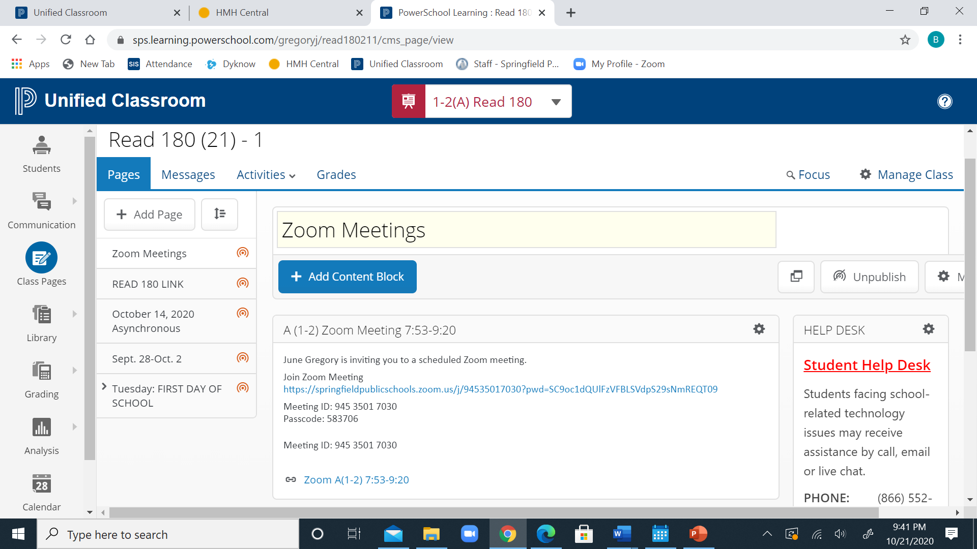
UNIFIED CLASSROOM

Slide 6
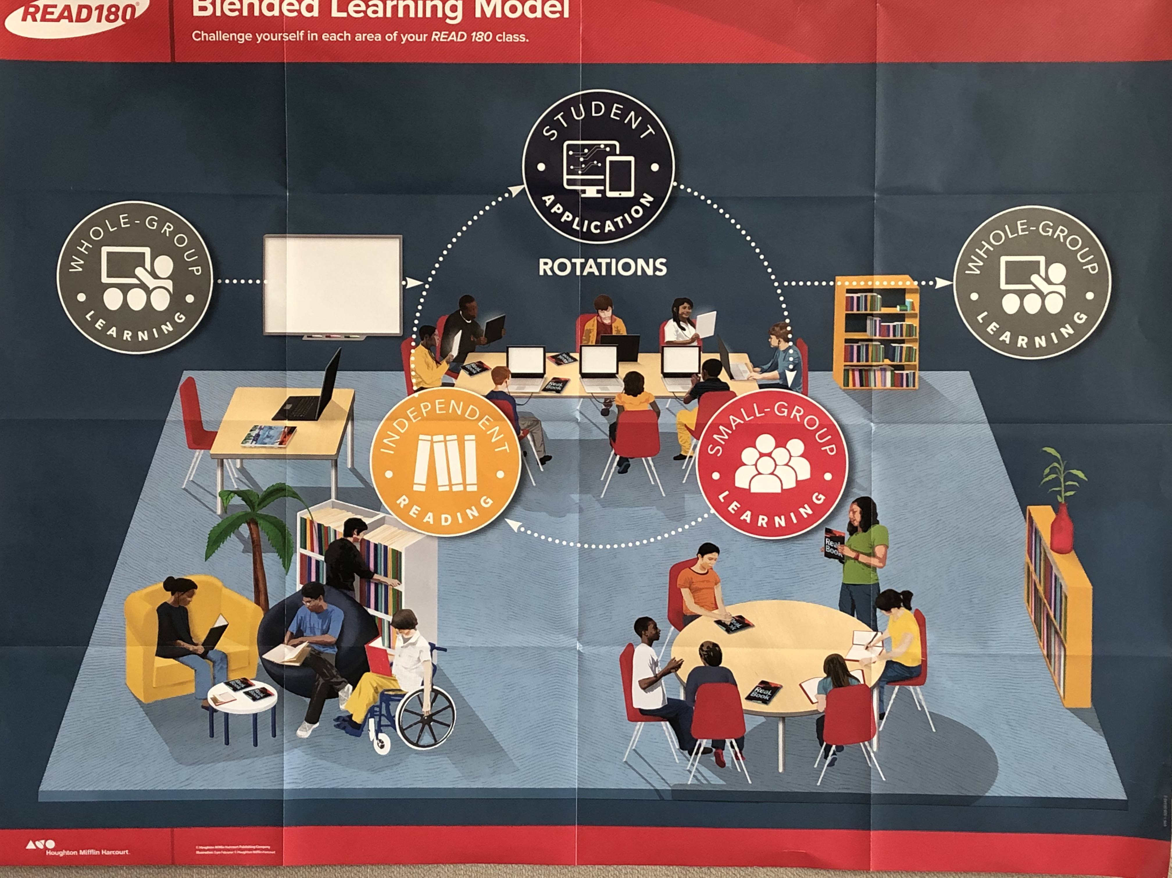
Read 180/System 44 Rotations
1st block
Whole Group Lesson
REAL BOOK
2nd Block
20 minutes of APPLICATIONS-this is the heart of the Read 180 Program
20 minutes of INDEPENDENT READING
https://h100003550.education.scholastic.com/HMHCentralGateway/

Slide 7
GRADING
  Grading- Grades are based on the Scholastic READ 180 model. The grade is divided into four parts, contributing to the 80-20 district policy.
Whole Group Work (20% of grade) – These activities include bellwork, daily participation points, whole group rBook activities, student discourse, and participating in outside reading activities.
Small Group Work (26.6% of grade) – This grade also consists of rBook activities, but it also includes written essays, individual instruction in weakness areas, Writer’s Notebook entries, rskills tests, and any small group projects.
**Small Group work will be combined with Whole Group during remote learning.
Scholastic READ 180 Software (26.6% of grade) - This grade consists of all activity on the instructional software which is at the heart of READ 180. This computer program individualizes instruction for each student who signs in. This is an integral part of the program. This grade also includes the student’s oral fluency grade.
Independent/Modeled Reading (26.6% of grade) – This grade consists of self motivation and self checks. The first part is a daily reading log which must include the date, pages read, and a response to that day’s reading. The second is portion of this grade is the actual test on the novel. Projects may be substituted for tests in some situations.
Book quiz - Three per marking period, taken on the computer
Book Project - One student-selected project for each book - due no more than three days after completion of book.
------------------------------------------------------------------------------------------------------------

Slide 8
Class Rules
  Be Respectful to all students and staff
  Enter the Zoom classroom with your microphone muted
  Cameras must be on with full face on camera
  Be punctual
  Remained engaged
  Be prepared with your Read 180 link bookmarked
  Be prepared with your textbook and pen handy
  During Independent work, text all questions in the chat

Slide 9
ASYNCHRONOUS WEDNESDAYS
Students will complete:
20 minutes of the Read 180 or System 44 STUDENT APPLICATIONS
And
20 minutes of INDEPENDENT READING
https://h100003550.education.scholastic.com/HMHCentralGateway/

Slide 10
Office Hours:
Wednesdays at 10:00 a.m.
Join Zoom Meeting by appointment
https://springfieldpublicschools.zoom.us/j/86351214334?pwd=OU9iN1NrbmZhRm95ek1pSSt1bU8yZz09
Meeting ID: 863 5121 4334
Passcode: 091571
gregoryj@springfieldpublicschools.com

Slide 11
Student Help Desk
Student Help Desk
Students facing school-related technology issues may receive assistance by call, email or live chat.
PHONE: (866) 552-0486
LIVE CHAT: https://support.customms.com
EMAIL: studenthelpdesk@springfieldpublicschools.com
CC: gregoryj@springfieldpublicschools.com

Slide 12
Thank you for taking the time to review the Read 180 program!
Mrs. Gregory

