Slide 1
C. T. Gorman
Intro Physics
Biology

Slide 2
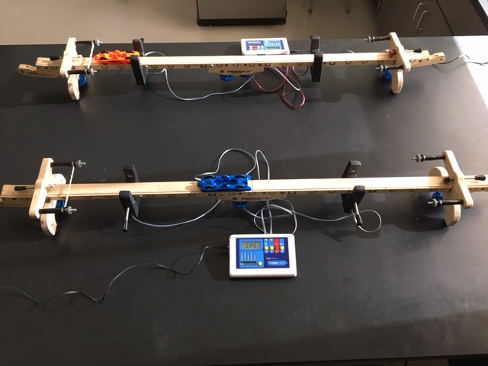
Welcome to Putnam Vocational Technical Academy's
OPEN HOUSE
track setup to investigate motion

Slide 3
My name is Christopher Gorman
I am starting my fourth-year teaching at Putnam. I have a Bachelor’s and a Master’s in Science and a MAT from University of Massachusetts and Texas Tech. I enjoy teaching and enabling students to discover the world through science.

Slide 4
Teacher Contact Information
Also found on your student’s Unified Classroom’s Class Pages on the Welcome page.
Email: gormanc@springfieldpublicschools.com
Google Voice: call (413) 351 7860
I will get back within 24 hours during the school week with any questions or concerns that you may have.

Slide 5
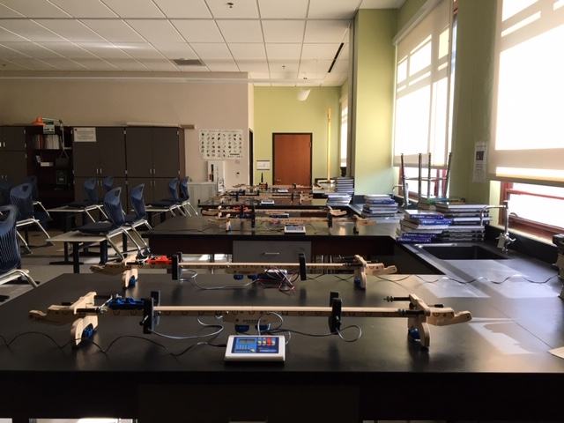
Classroom Paraprofessionals
For the year 2021 – 2022, there are no classroom paraprofessionals working with Mr. Gorman.
classroom track setup to investigate motion

Slide 6
Schoology Classroom Page
THROUGHOUT THE DAY, YOUR CHILD HAS ACCESS TO THEIR CLASSROOM BY USING THE SCHOOLOGY CLASSROOM PAGE

Slide 7
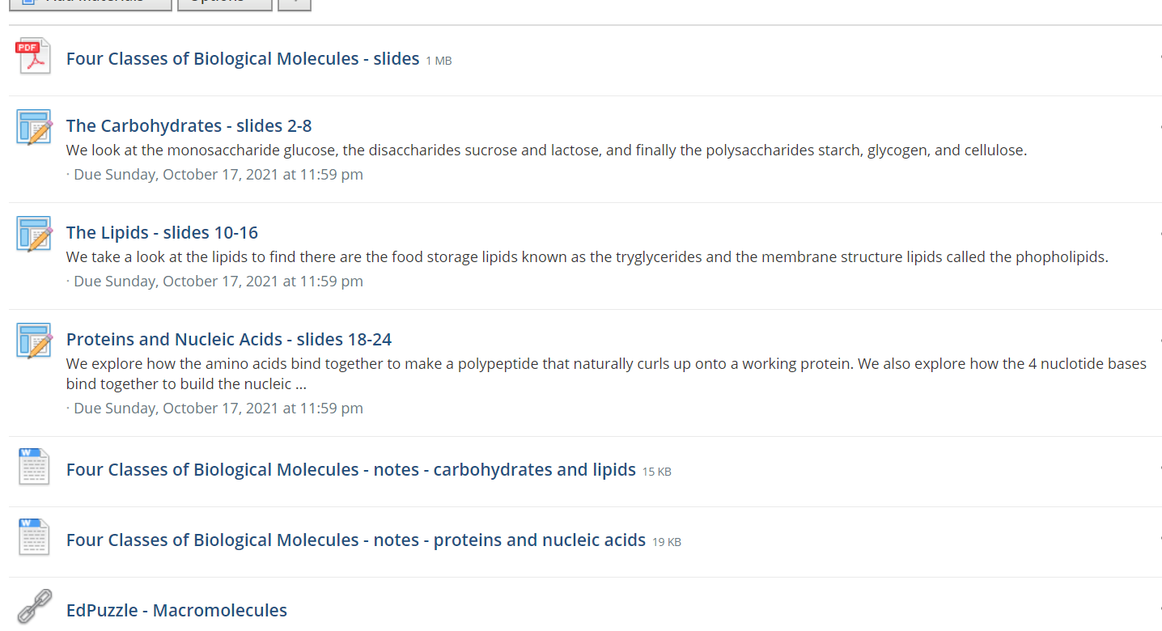
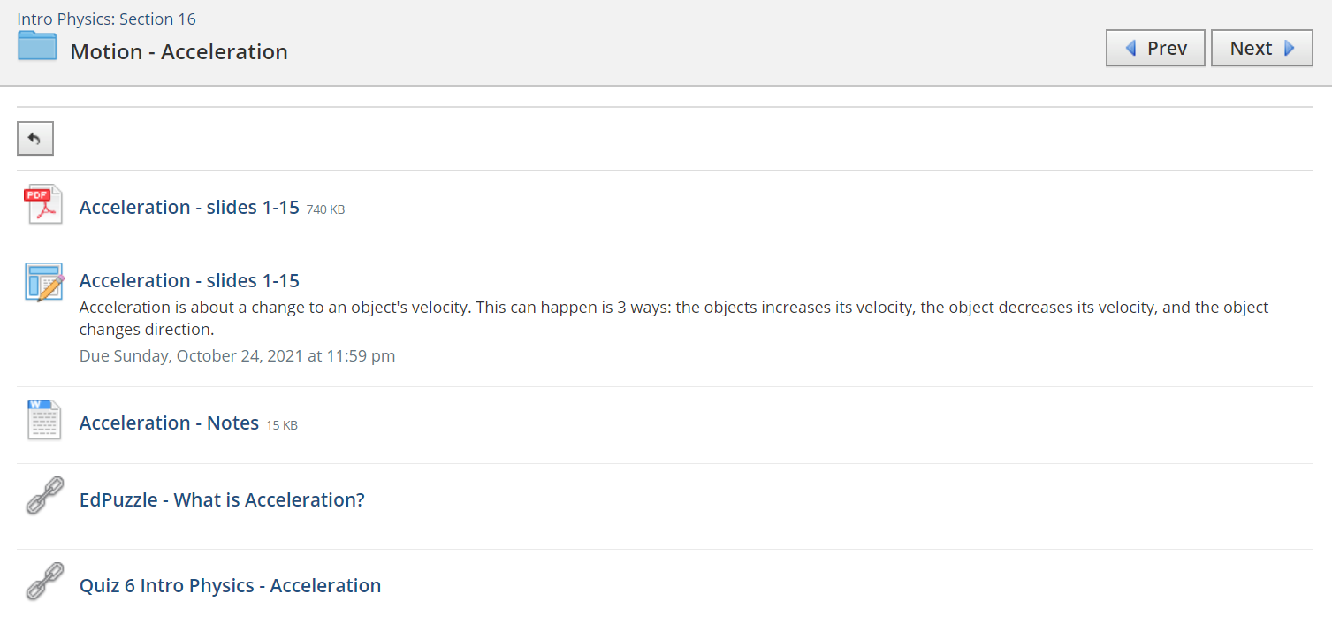
Example of a Daily Agenda page for a Physics Classroom
Example of a Daily Agenda page for a Biology Classroom

Slide 8
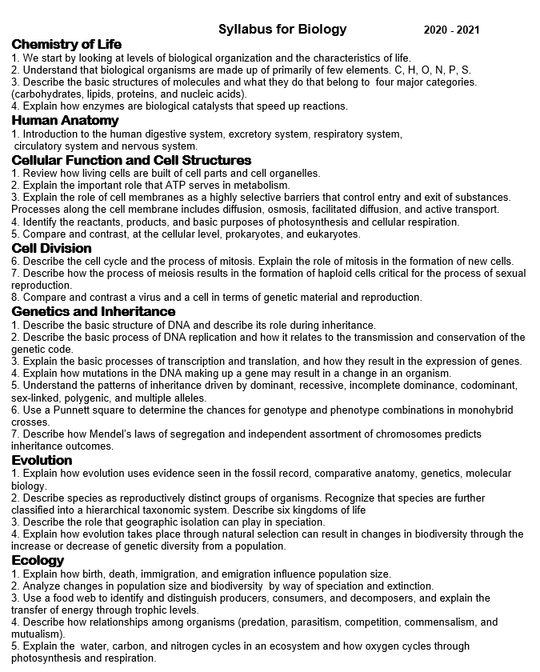
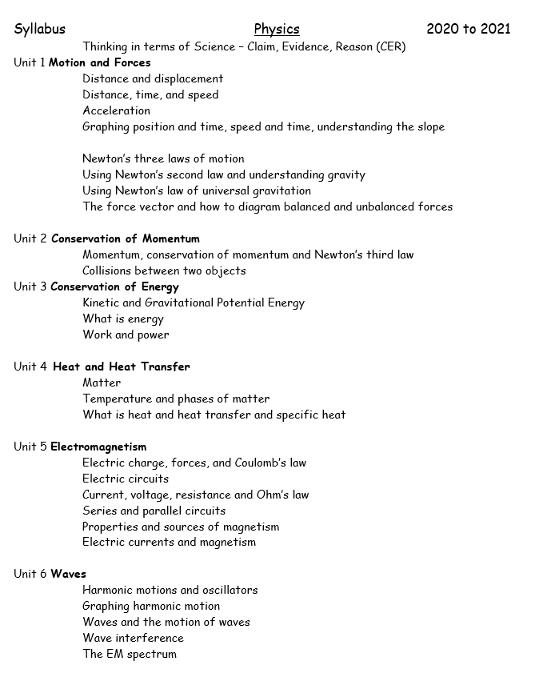
Syllabus for Biology
Syllabus for Introductory Physics

Slide 9
STUDENT TECH HELP DESK
Student or parents dealing with school-related technology issues may receive help by phone, email, or by live chat. The bilingual Student Help Desk is available from 7 a.m. to 8 p.m. Monday through Friday (except holidays).
PHONE (866) 552 0486
LIVE CHAT https://support.customms.com
EMAIL studenthelpdesk@springfieldpublicschools.com

Slide 10
Student Expectations for In Person Learning
Know your weekly class schedule.
Arrive to the classroom on time.
Find your assign seat to allow for contact tracing.
Bring your laptop and charging cord.
Have your laptop out and open.
Understand the day’s mini-lesson, activity, and check for understanding.
Submit assignments on-line by the due date.

Slide 11
Teacher Expectations
Provide weekly/daily agendas for students.
Check email regularly.
Take attendance.
Have help sessions available every day after school.
Provide feedback on submitted assignments.
Respond to student/parent questions within 24 hours during the school week.

Slide 12
Grading Policy
Formative Grades
20% of your quarterly grade
Various assignments and activities centered on the main topic
Summative Grades
80% of you quarterly grade
Assignments include but are not limited to:
District Standards-Based Assessments
Quizzes
Informal Quick Quizzes at the end of class
Extra Credit
No, not in this class. Do your original work, do it well.
Quizzes on-line can be taken again if grade was particularly low.
Reflect on feedback and be ready for assessments which are usually small in size and given regularly.

Slide 13
Grade Level Information
9th Grade Dean T. Ryan ryant@springfieldpublicschools.com
office phone number: ext 58820
10th Grade Dean B. Scott scottw@springfieldpublicschools.com
office phone number: ext 58160
11th Grade Dean I. Torres torresi@springfieldpublicschools.com
office phone number: ext 58848
12th Grade Dean G. Genese richards-geneseg@springfieldpublicschools.com
office phone number: ext 58125

