Slide 1
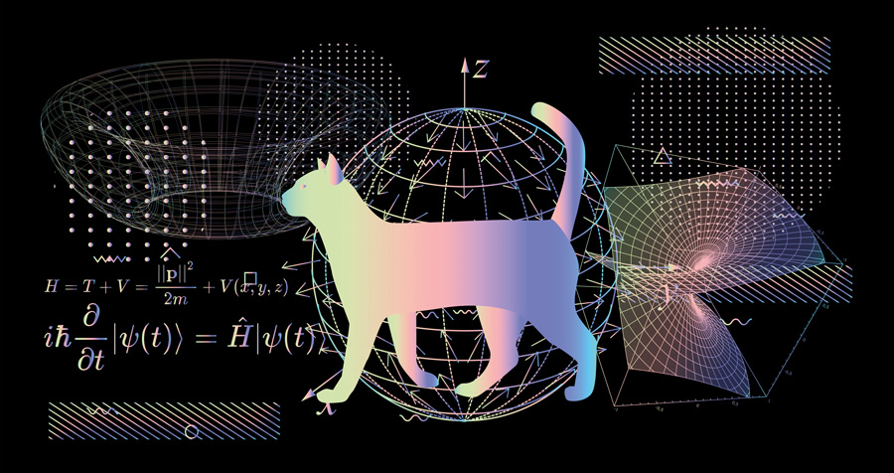
Mrs. Hahn Clark
Hello! I am Mrs. Hahn Clark, and I am teaching this year's freshman Physics and Science Enrichment as well as this year's seniors Anatomy and Physiology.

Slide 3
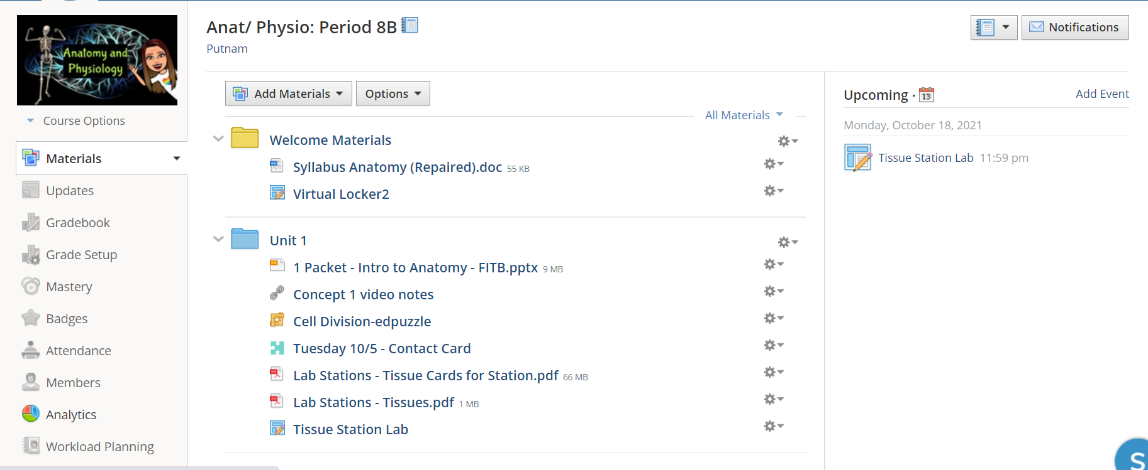

Slide 4
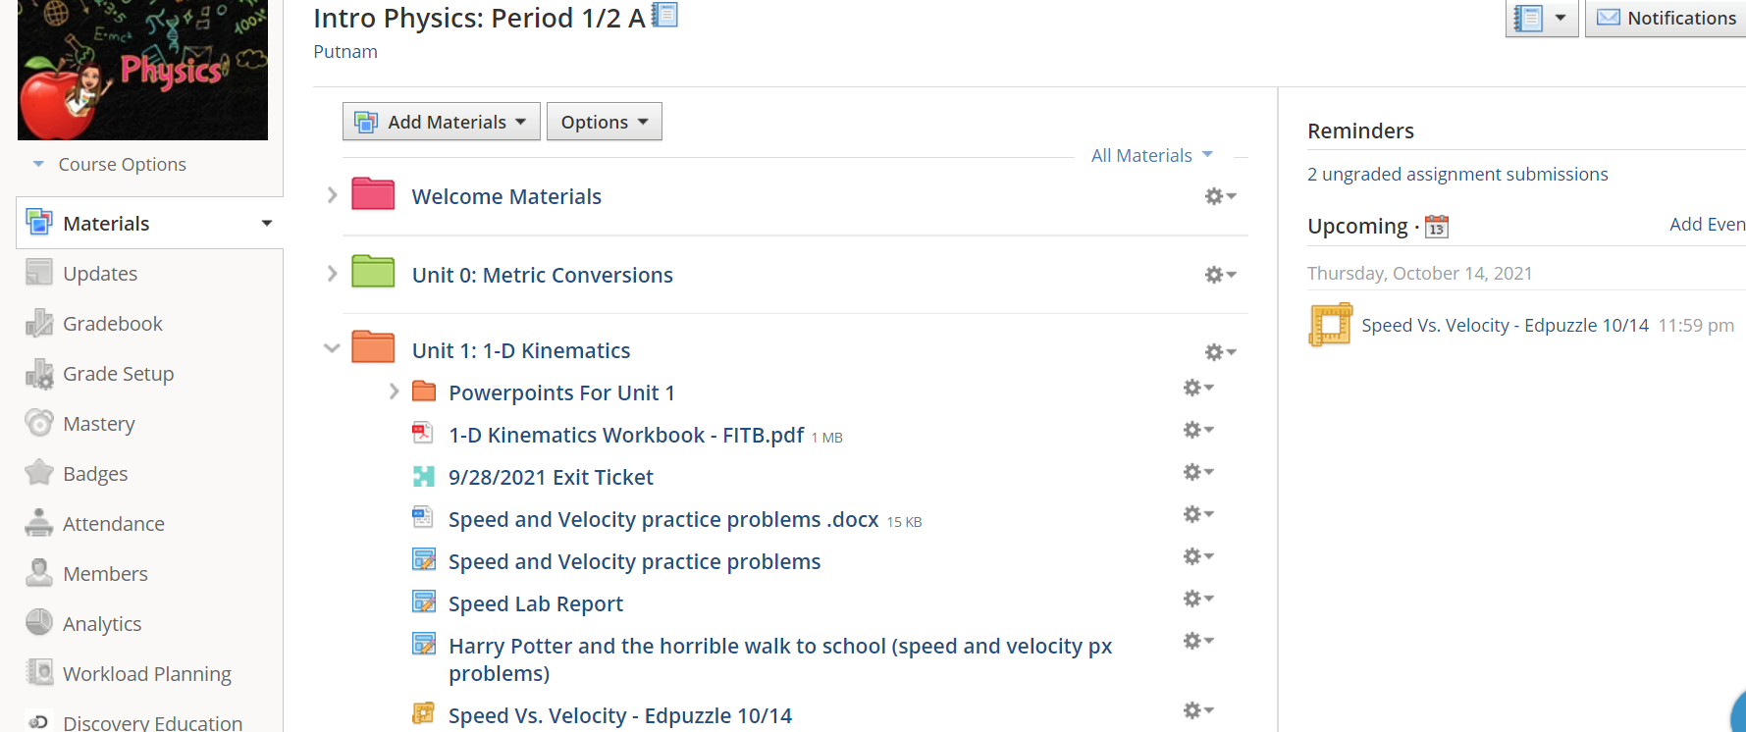

Slide 5
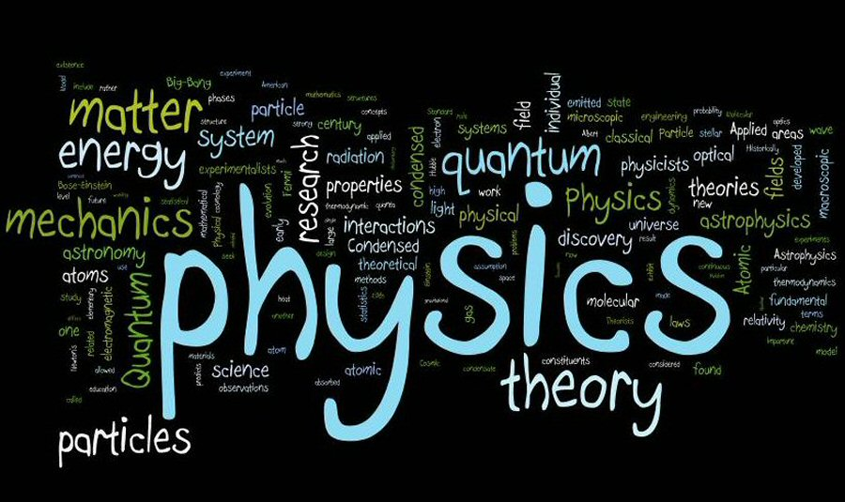
Mrs. Hahn Clark
Hahn-clarks@springfieldpublicschools.com
Google voice: 413-569-8879
Office Hours: Wednesday 2:30 to 3:30

