Slide 1
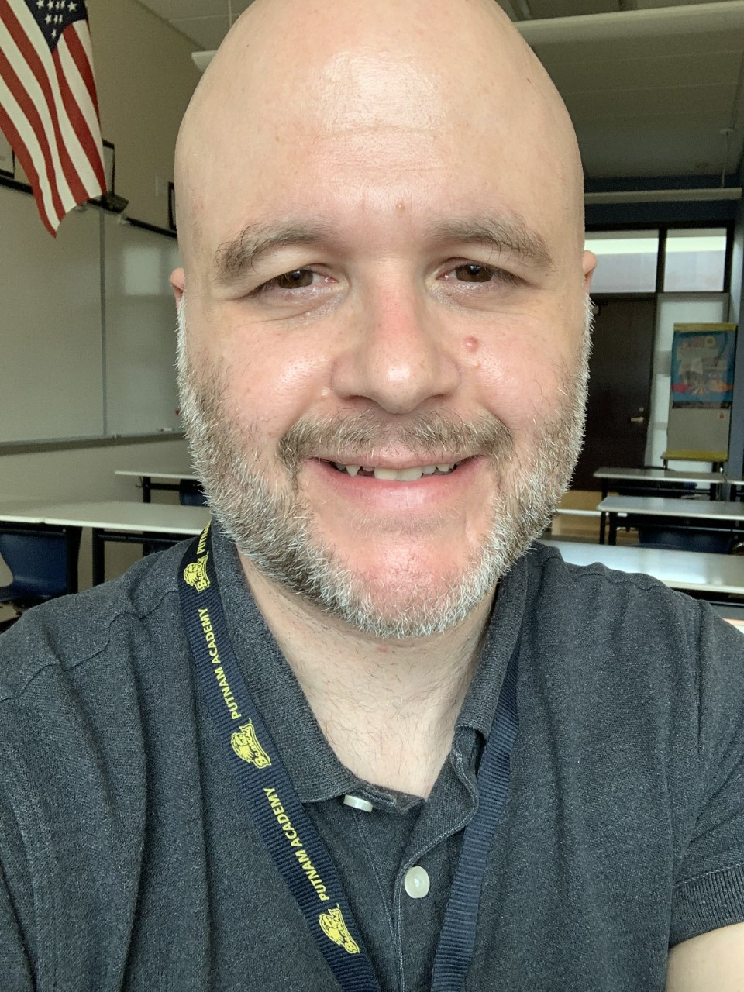
Welcome Putnam Families!
Mr. Rooney
ESOL Level 1-3

Slide 2
Schoology – Where to find our class!
Access, work on and hand in classwork Complete assessments and essays Find the presentation for the day Check due dates Check your grades

Slide 3
One Note – Find class notes
Find activators and objectives for the day Take notes in your class notebook Get teacher feedback before submitting assignments on Schoology Get caught up on class notes in “Content Library”

Slide 4
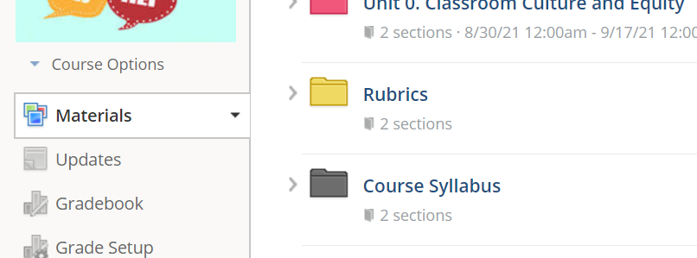
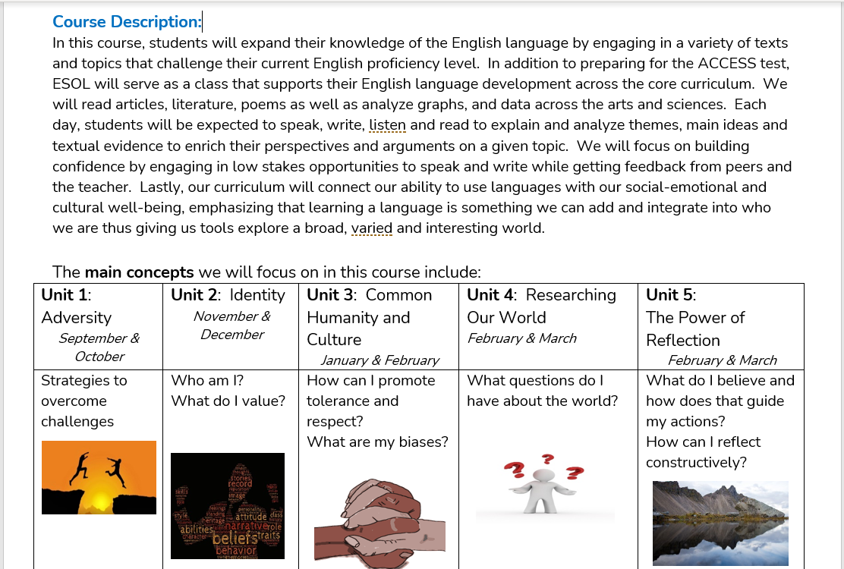
Class Syllabus – What are we learning?
Developing English Language skills in all 4 domains: listening, speaking, reading and writing Studying a wide range of topics from adversity, identity, common humanity, research and reflection. Read a wide variety of genres and texts across core curriculum: articles, literature, poems; analyzing graphs and data Enriching Performance Tasks: presentations, essays, poems, articles, podcasts, dialogues

Slide 5
Mr. Rooney – Contact Information
Email – rooneyc@springfieldpublicschools.com Please text me on Talking Points – I’ve sent out welcome text messages (email me if you did not receive one). Google voice: ‪(413) 342-1732‬ Office Hours – Wednesdays – 3:30PM – 4:30PM

