Slide 1
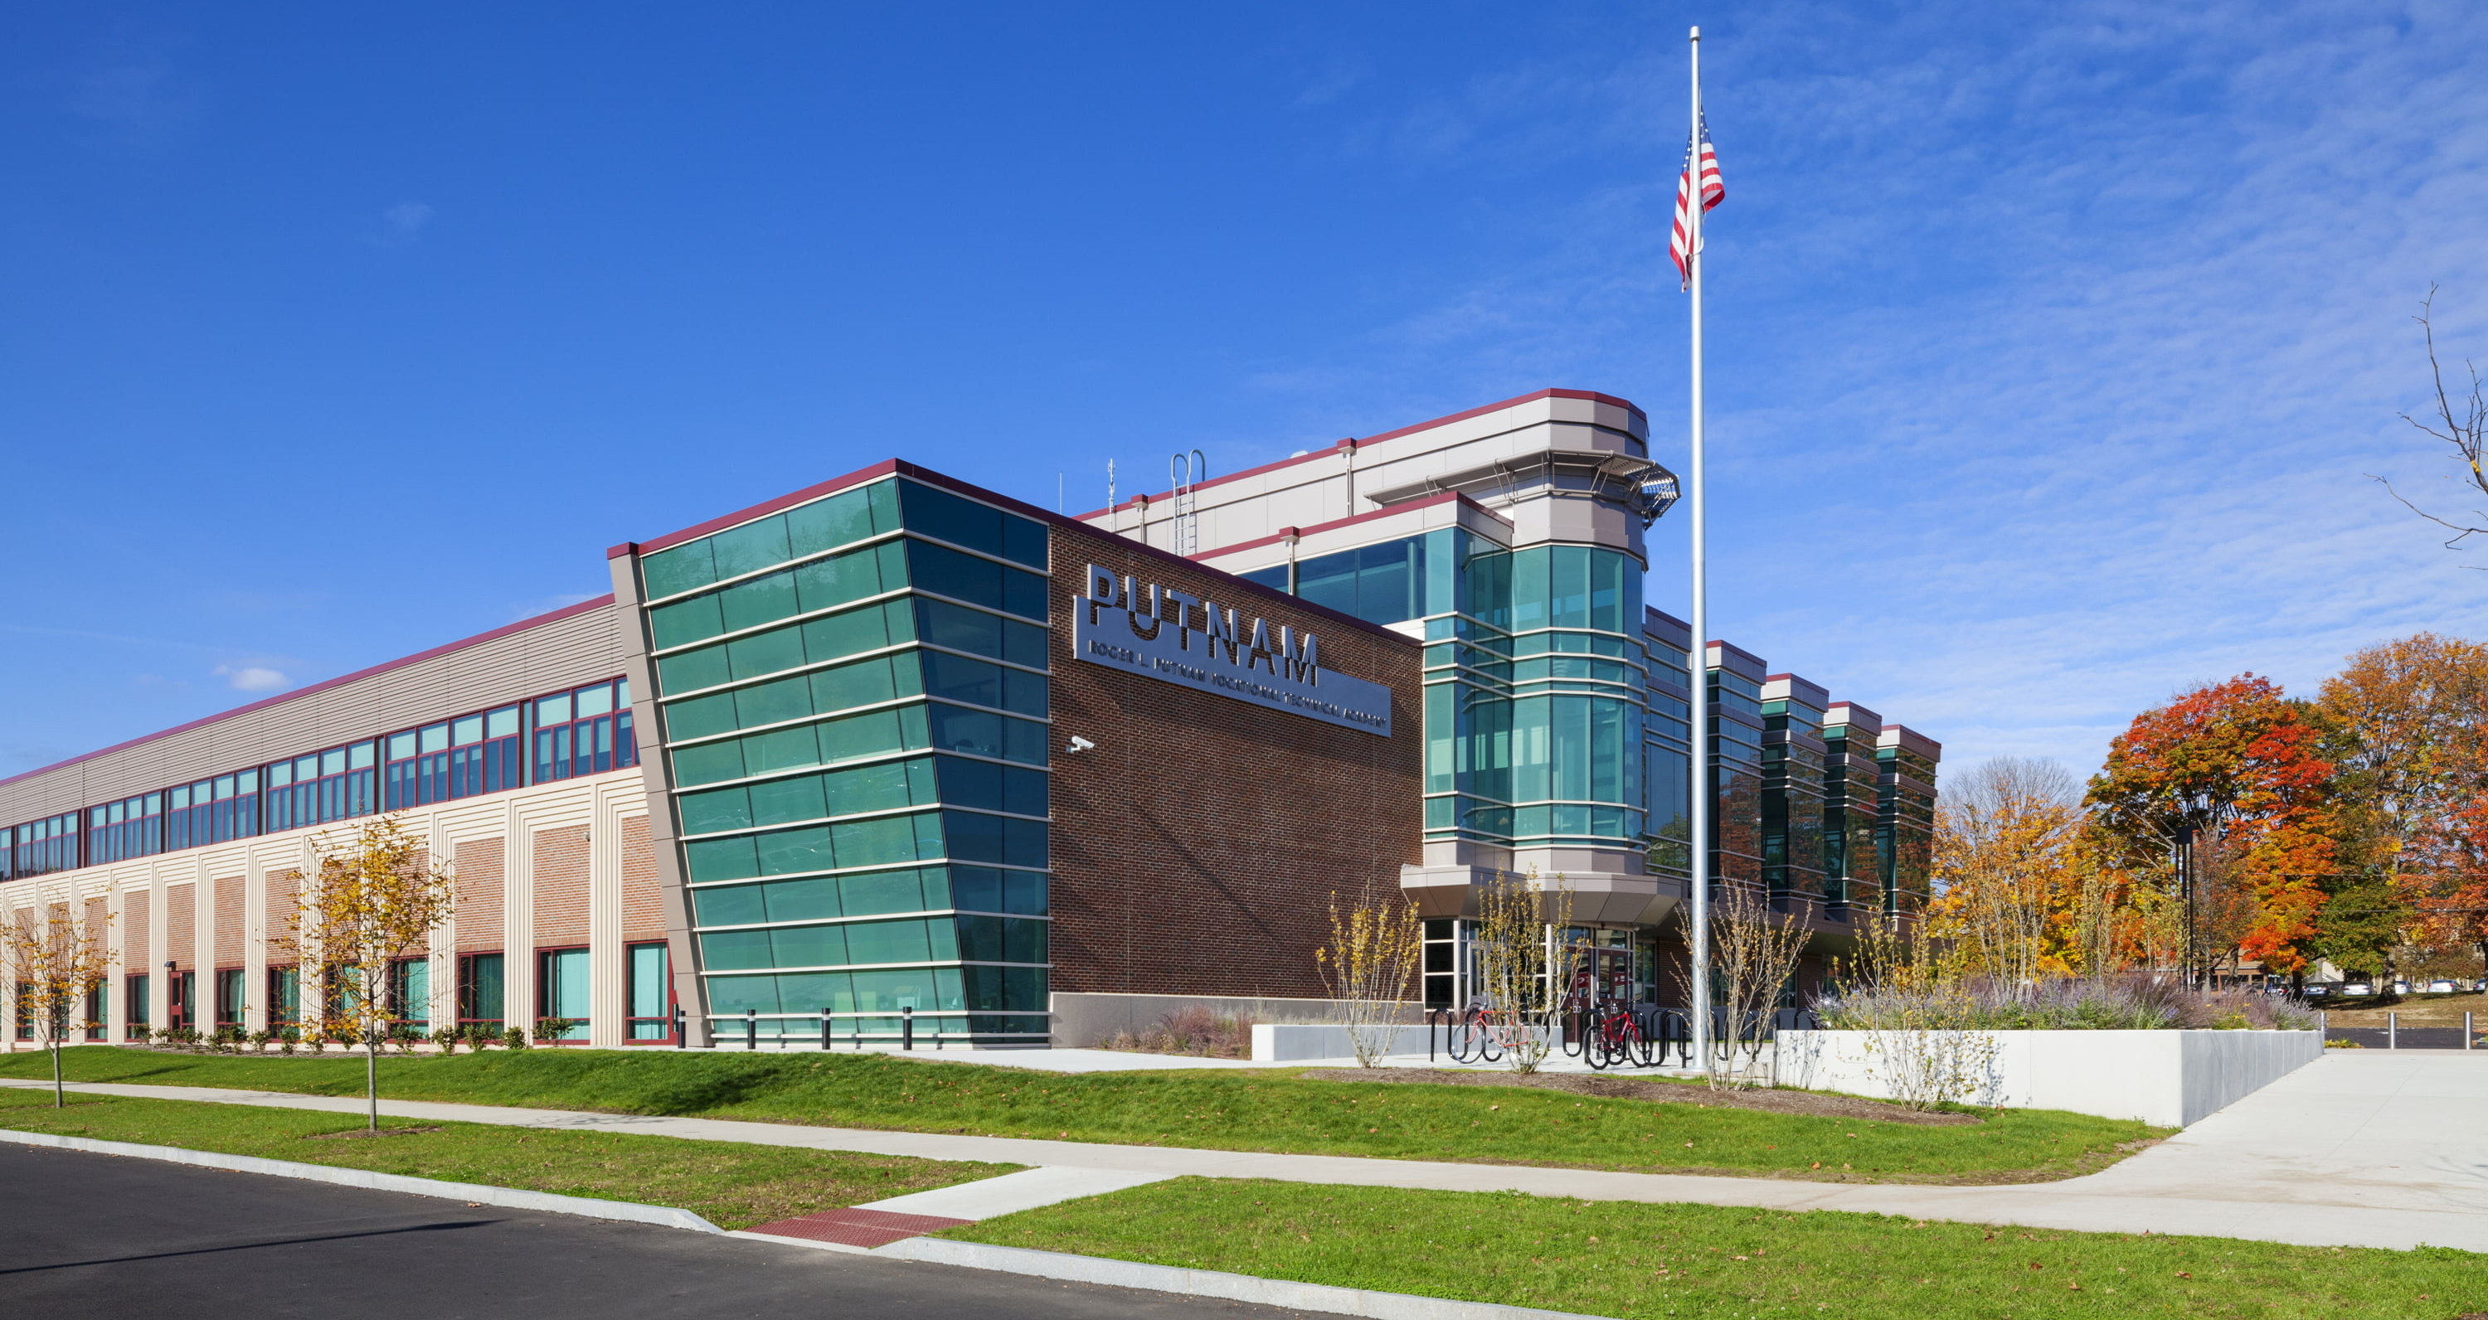

Welcome to Putnam
Ms. Atkinson
Special Education
Mathematics
BS: American International College Southern Connecticut State University
MS: Special Education – Springfield College

Slide 2
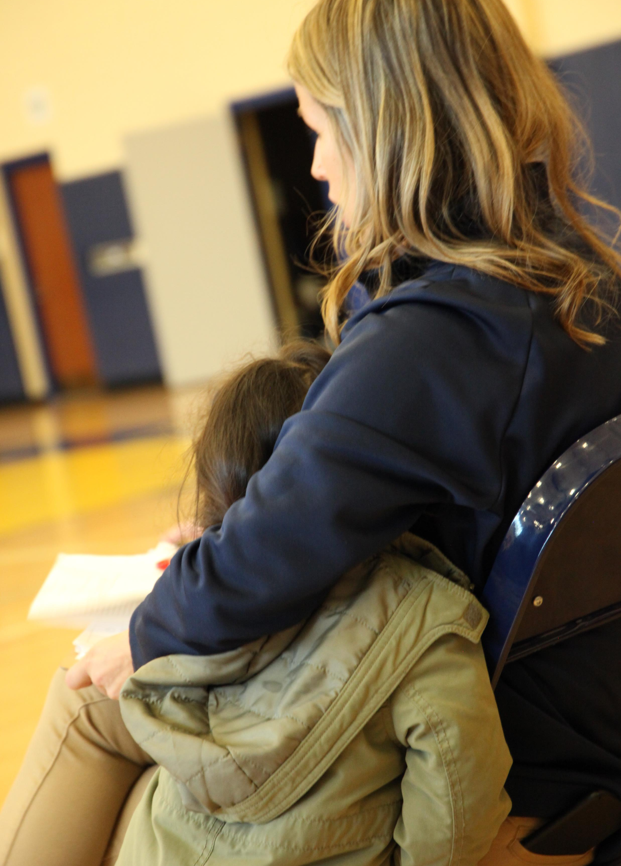
Name: Ms. Atkinson
Email: atkinsonc@springfieldpublicschools.com
Google Voice: 860-263-9441
Room: c208
Algebra l, Algebra ll, & Enrichment 10

Slide 3

Links!
Classroom assignment applications
Agile Mind
Delta Math
Khan Academy
Student Links (SPS Page) (Use for Big Ideas, Discovery ED, Unified Classroom, student portal)
Class Pages – schoology
Support Services:
Graphing Calculator - DESMOS
Khan Academy
You Tube - Two Step Equations

Slide 4
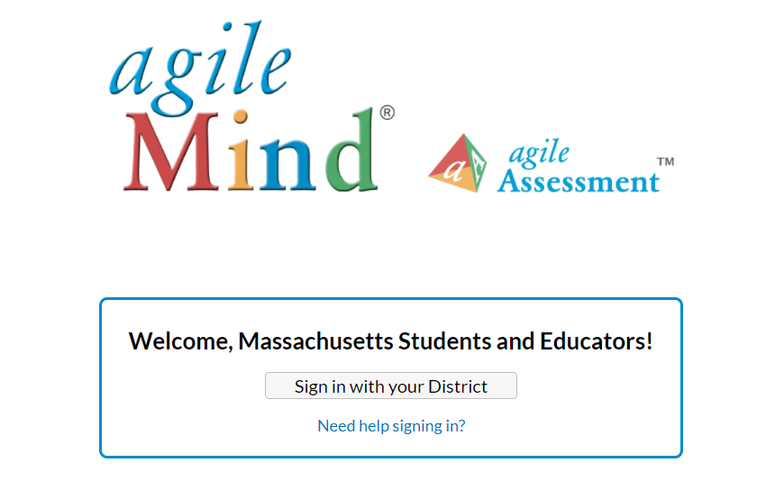
Agile Mind

Slide 5
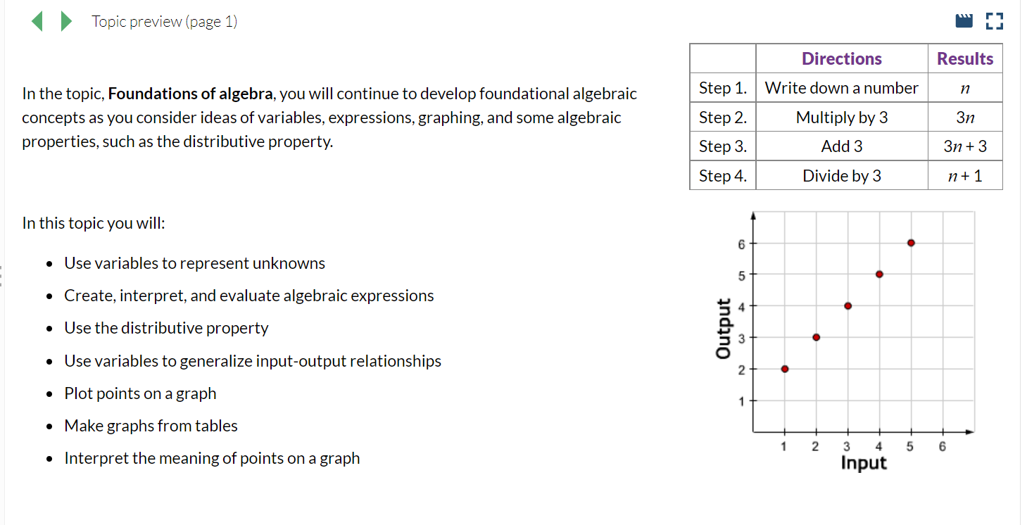
Agile Mind- Online

Slide 6
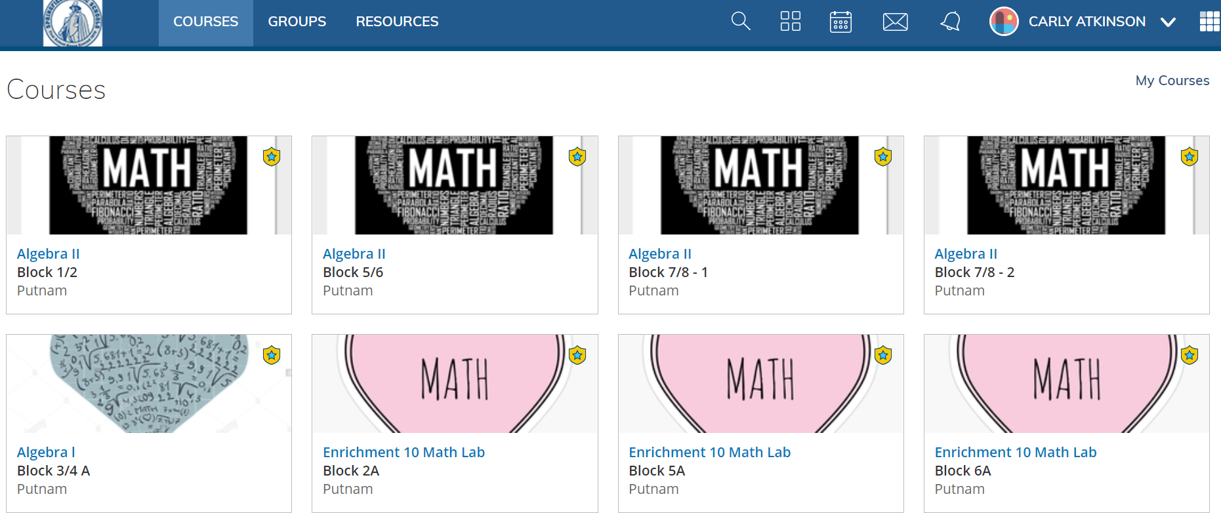
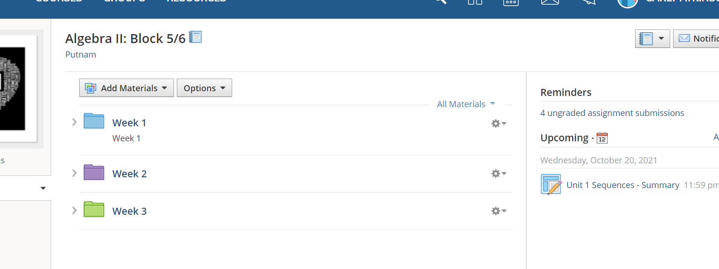
Schoology

Slide 7
